Slide 1
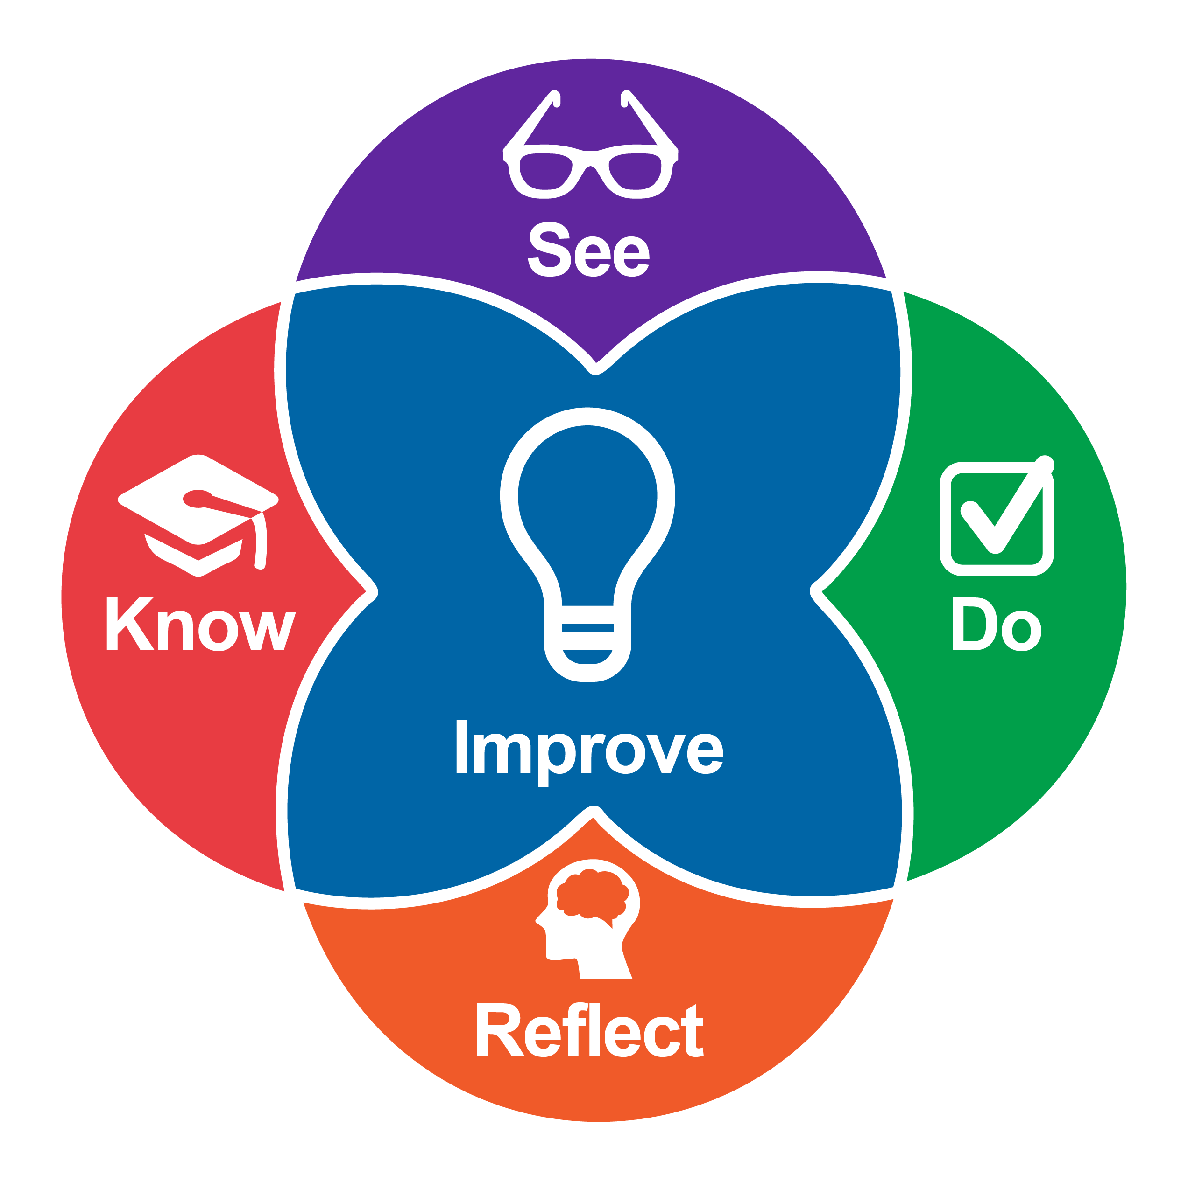
Honing our Practice
An Introduction and Practice
Notes:
Welcome to an exciting phase of your learning journey where we will come together to learn how to be purposeful in improving our teaching practice so we can help ourselves, our children, and our families to thrive. The Intentional Teaching Framework is a tool you can come back to again and again throughout your career. Let’s get started!

Slide 2
Table of Contents
Section Title | Slides
Introduction to the Intentional Teaching Framework (ITF) | 4-13
2. Crafting Learning Together | 14-15
3. Owning the ITF | 16-17
Notes:
Note to Instructors: There are three sections to this slide deck and represent three separate explorations and applications of the Intentional Teaching Framework
Introduction to the Intentional Teaching Framework (slides 4-13): This section provides an overview of the framework and each of its elements. The purpose is so learners will understand our approach to teaching practice-based learning in early childhood. Providing explicit guidance in the purpose of this approach to learning allows them to own the learning process and motivates them to acquire the skills effective teaching requires.
Crafting Learning Together (slides 14-15): This section suggests how to increase learner autonomy by having them use the ITF to create a learning cycle related to a teaching practice of interest. By having students do this together we leverage the power of collective thinking. Suggestions for extensions are provided and many of the learning cycles created could be applied in other coursework.
Owning the ITF (slides 16-17): This section suggests using the ITF as an individual planning tool. Again, by increasing autonomy over the specific teaching practices the learner focuses on we can increase motivation. This section also suggests letting learners work on their planning collaboratively, but in support of their individual learning.
While all of these focus on having the learners explore and develop their own understanding of the Intentional Teaching Framework, we invite instructors to use the ITF handout and these slides to craft their own practice-based course work.

Slide 3
Learning Outcomes
Introduction to the Intentional Teaching Framework: Learners will explore the elements of the framework and be able to articulate how they work together to support learning about teaching.
Crafting Learning Together: Learners will collaborate and use the ITF to design a cycle of learning about their own choice of specific teaching practices.
Owning the ITF: Learners will use the ITF to design a cycle of learning for their own learning based on their interest in specific teaching practices.

Slide 4
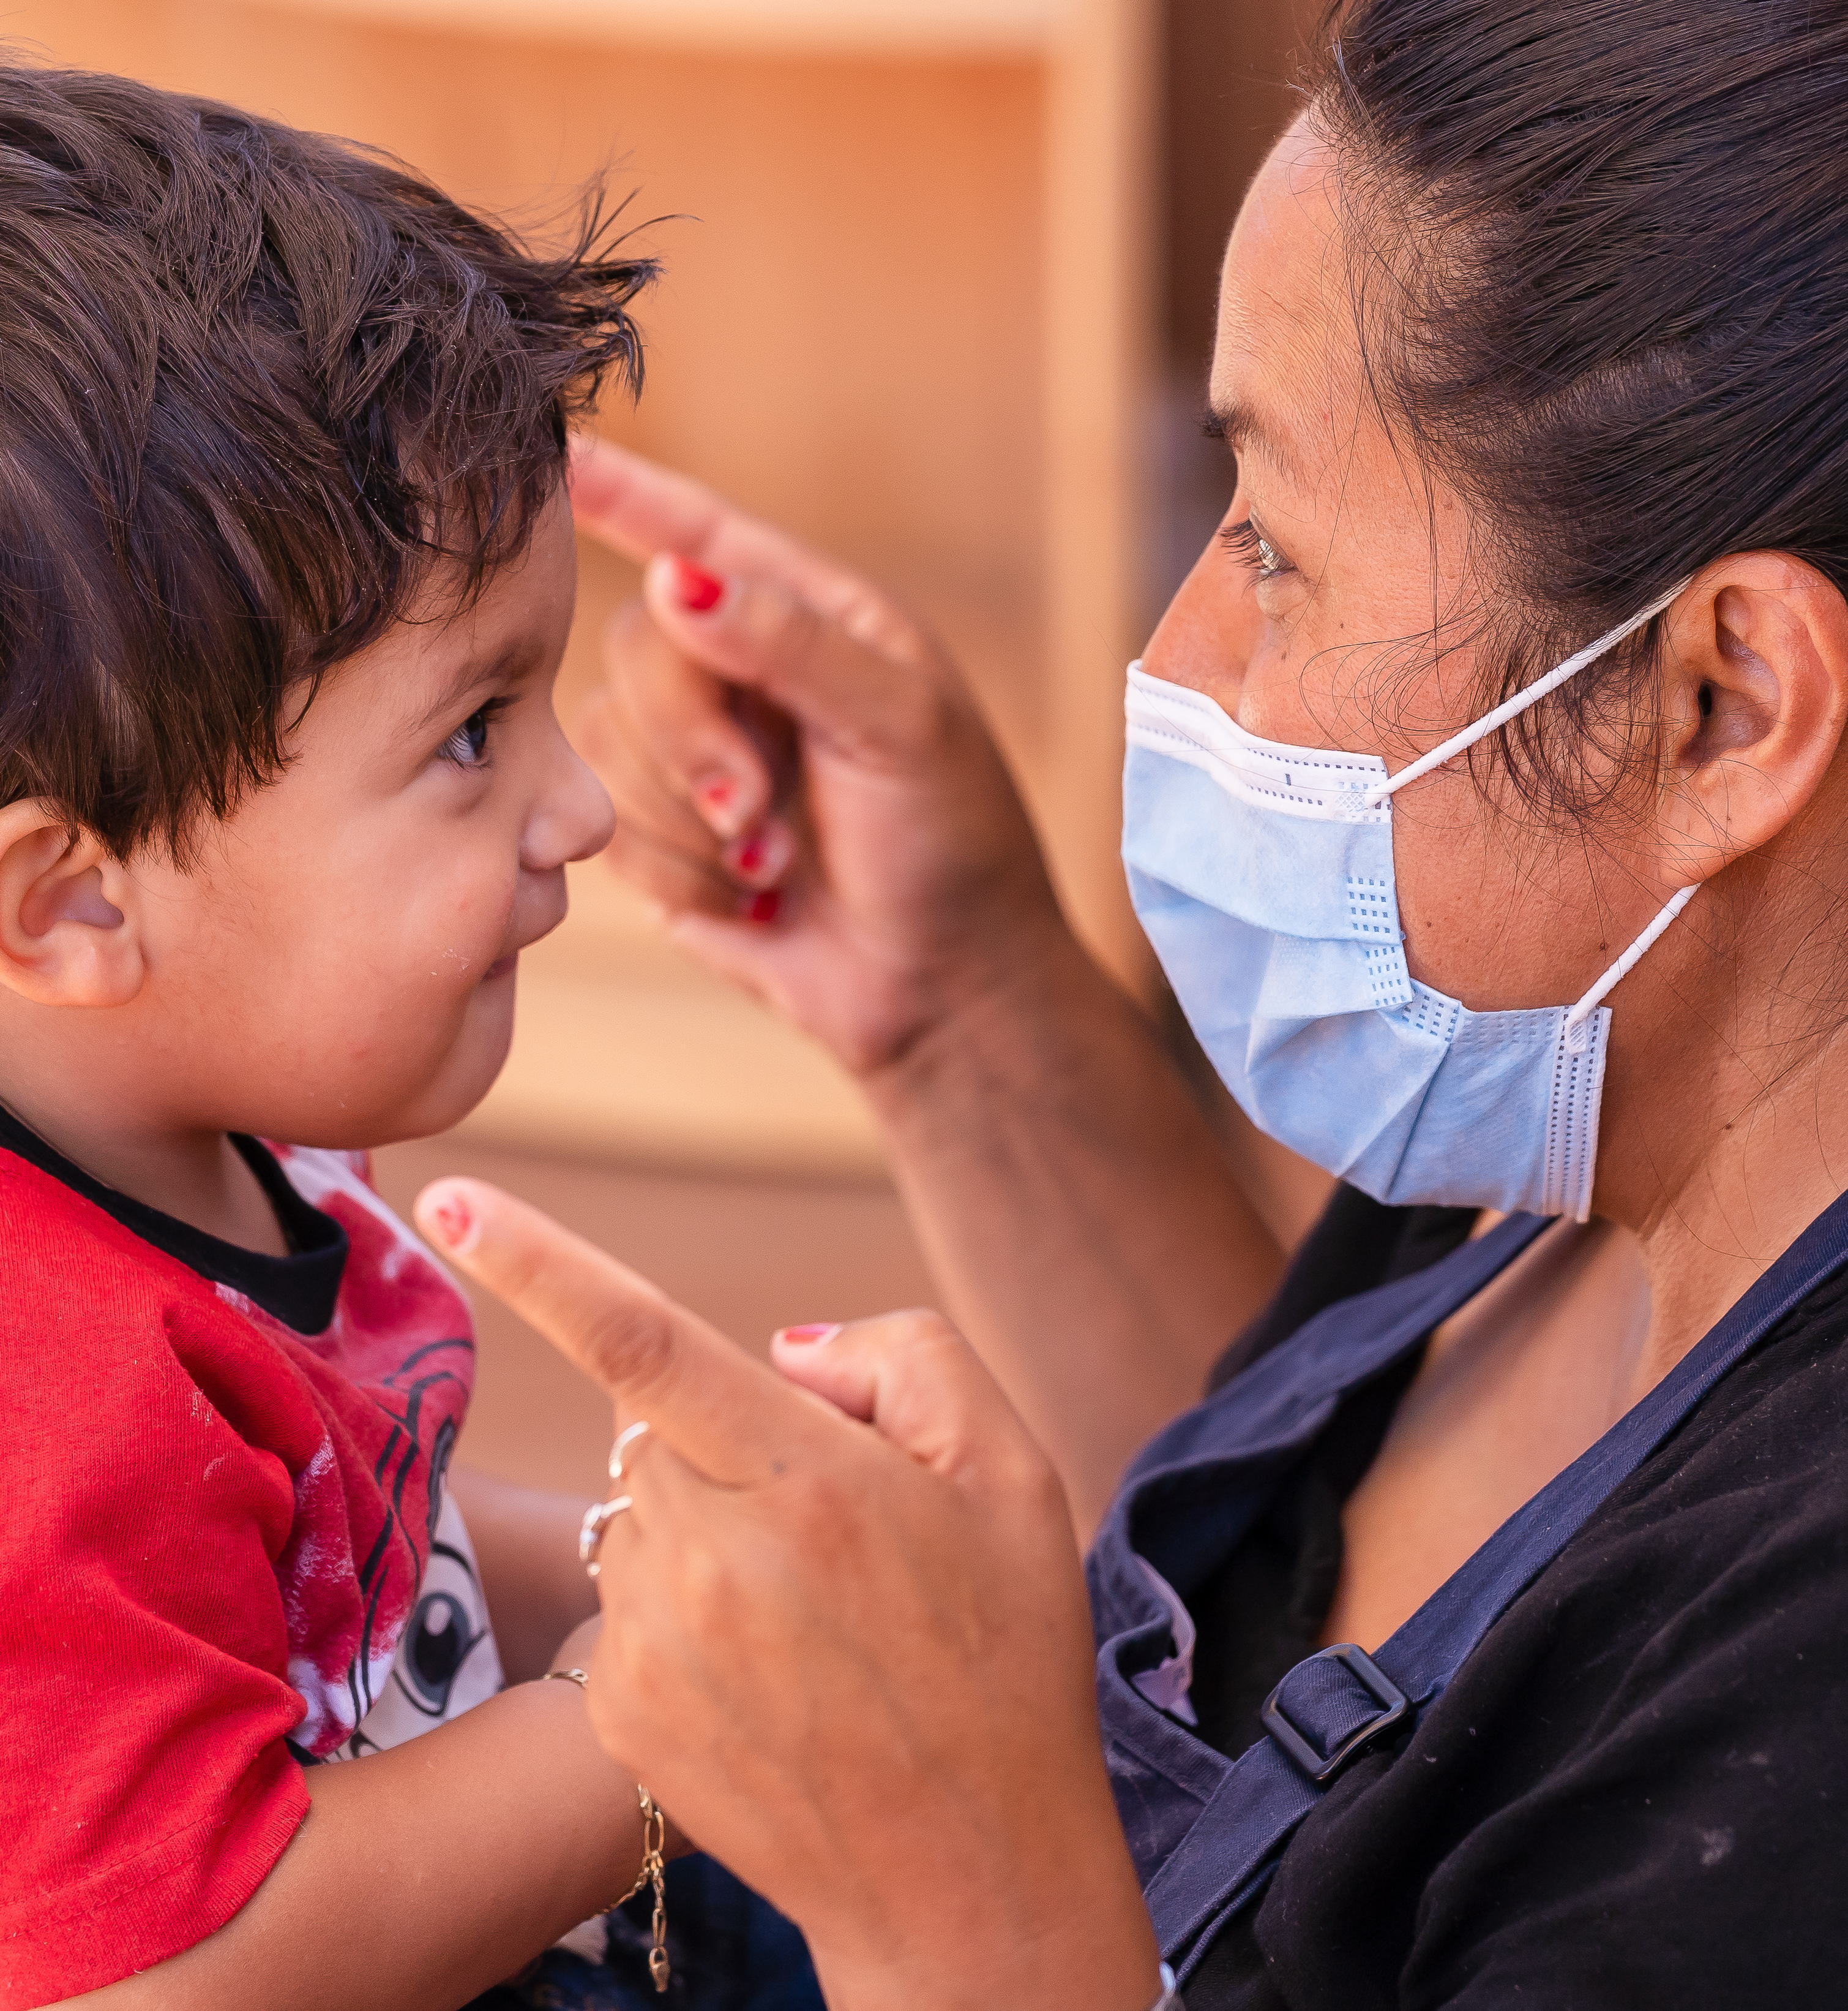
Community Agreements
Stay engaged
Speak your truth
Listen to understand
Keep confidentiality
Ask for help
Support one another
Notes:
Presenter Notes:
Let’s review the community agreements we have created. This is a reminder that we all agree to stay engaged, speak your truth, listen to understand, keep confidentiality, ask for help when you need to, and support one another.
Is there anything you would like to add, or is there anything you need today to make you a successful learner?
Make sure to always ask, in addition to checking in on these standing agreements:
“Is there anything else you need during this time together?”
This allows someone who might have a plumber, etc. coming during this time to let everyone know they may need to step away or turn their camera off. Another example could be a parent who has a child who may be calling home sick from school. We want to make sure the community feels safe and held.
These are just suggested agreements. We recommend that you create a list with your group of learners at the start of each term and revisit in each class session. You can copy this slide and paste into the start of each of the sections you decide to offer.

Slide 5
Introduction to the Intentional Teaching Framework
What is going on here?
What do you see that tells you that?
What else do you notice?
Notes:
Ask learners about what they notice
Pictured on the slide is the Intentional Teaching Framework, or ITF. Based on what you see in the picture, what do you think are some of its defining features and how does it work?
Possible answers:
Learners may point out that the circles are overlapping and not laid out as a linear process. They may also notice that “Improve” is in the center of the framework and is the largest component, so it must be an essential piece that is perhaps supported by all the other components. Learners could also notice that engaging in the framework must be an active process based on words like, “Do” and “Reflect.”
Introduce the Framework
The goal of the Intentional Teaching Framework is to help educators improve their teaching practice. All of us already have a lot of knowledge and skills when it comes to supporting the growth and development of children and families. We also have the desire to extend our capabilities and continually strive toward being the best educators we can be. The Intentional Teaching Framework offers us a purposeful way to maximize the potential that already exists inside all of us. There are five elements of the Framework: 1) Know, 2) See, 3) Do, 4) Reflect, 5) Improve. We will discuss each of them in more depth on the next slides.
Before we move on, there are a couple important things to note:
You may have already noticed in the graphic of the ITF that all the elements overlap. That is to show that there is not a specific step-by-step order in which these phases occur. They may even happen at the same time!
Further, you can see there are no numbers on the model, indicating that one can enter the model or the process from any point. For example while you are in a classroom "doing" it may activate something that you want to reflect on, find out more about, and maybe see someone else do. Or I may introduce new content to you and offer you some video examples that you then decide to practice in the classroom and reflect on.
The Framework provides us with an iterative cycle for structuring our own learning and development. We can come back to it again and again as we seek to continually improve our teaching.
Note to instructor: Maybe brainstorm a few ways learners can imagine moving through the model.

Slide 6
Improve
What makes a useful focus for improvement?
Linked to child outcomes, cultural practices, state, national, tribal standards
Communicated clearly to yourself, instructor, and peers
Focused on your improvement over time through feedback and support
Able to be measured by evidence of practice
Notes:
We’ll begin by focusing on the center of the Framework, “Improve.” That’s because it is important to start with a clear understanding of what you want to do better, or differently, and to share that with the people in your community who will support you along the way.
Your goals for improvement should be specific, descriptive, and focused. It should be clear what “success” looks like and how you will demonstrate your improvement. Since the purpose of using the ITF is to improve our teaching practice, it’s also important that what you want to improve is clearly linked to child outcomes, cultural practices, state, national, and tribal standards.
Like the Miskwaadesi, the Ojibwe/Anishinaabeg word for the painted turtle, reminds us that we may 'move slowly, but each move is deliberate, intentional, and focused toward the future....[and] a painted turtle will only eat its food while in the water, a testament to the importance of the environment to support [our] ability to engage.'
Note to Instructor: You can choose to brainstorm some focus for improvement here if you choose. You will have an opportunity to do so later. If you choose to do so, focusing on making them specific and descriptive which can sometimes be challenging especially for new educators.

Slide 7
Discussion: Your goals to improve
Think about a time when you set a goal to improve something you do.
What helped you succeed in achieving it?
What got in the way of helping you achieve it?
Notes:
Think about a time when you set a goal to improve some practices you may already engage in or wanted to learn more about. Maybe you’re working toward something now, or you have goals you set in the past. It doesn’t have to be related to teaching. [NOTE TO INSTRUCTOR: Share an example of one of your behavioral/practice goals and note how it is descriptive and focused. If you have had an experience where you have set a goal that was too broad and that was part of the difficulty achieving it that would be great to share too. Identifying the purpose of being descriptive and specific is important here.]
What helped you succeed in reaching your goal? What are some things that didn’t help you–that perhaps made it more difficult for you to succeed?

Slide 8
Know
Some ways you can discover knowledge
Community gathering and elder cultural knowledge
Lived experience
Readings
Interviews with experts, mentors
Presentations and videos
Quizzes
What else?
Notes:
When you want to learn more about something, what do you do? You might read articles about it or listen to a podcast where an expert is discussing the topic you are curious to learn more about. What else might you do? How do you determine what you are learning is accurate or will lead to competence and mastery?
Once you have your focus for improvement in mind, you can seek out new knowledge about it that leads to your growth and development. Similar to how you might learn more about any topic you’re interested in, you can explore many resources on your own and with others to help you hone your knowledge around teaching practices. When you expand your mind and see learning as a never-ending journey, there are no limits to what you can do.
Note to Instructor: Identifying the strengths and challenges to each method of knowledge acquisition can be useful here. All of them have specific benefits and potential gaps. Considering these various ways can help students understand again, the purpose for what they are learning and the various tools and resources offered. Focusing on 'both/and' in this conversation will be more useful than 'either/or'

Slide 9
Discussion: Your path to knowledge
What can your instructor do to help you gain the knowledge you need to improve?
How can your peers and your community help you when you’re in the process of learning something new?
How do you know when you’ve really learned something?
Notes:
As your instructor I certainly can share resources to enhance your knowledge, and I will be here to support you when you have questions or want help finding out more about your chosen area of improvement. What does support from me look like to you?
How might you also use the support of your peers and your community at this stage? How can you check your understanding along the way and feel confident that you really learned something?

Slide 10
See
What helps us become more reliable observers and able to discuss what we see in productive ways?
Notes:
“Seeing” is where knowledge and teaching practices begin to come to life. Educators need to be able to accurately recognize or see effective teaching in themselves and others, including chances to see both exemplary and in-progress attempts at teaching skills. Having opportunities to view yourself and others in action provides invaluable opportunities to recognize effective teaching practices. Seeing practices in action also demonstrates the connection between identified focus for improvement and the knowledge you have gained from shared resources (the “know”).
This 'accurate recognition' is often called 'reliability' where there is agreement among different viewers about what they are seeing.
Video is an especially valuable tool here. By watching video of teaching practices – your own and others' - being used repeatedly in different contexts, we have a chance to slow down, pause the action, and start to notice individual elements of the otherwise busy – hectic, even – early learning setting. Watching in this way helps educators of all experience levels identify considerations to keep in mind when enacting teaching practices.
While watching or “seeing” teaching practices, educators can consider:
What’s going on in this interaction? What do I notice that tells me that?
What is going well? What seems challenging?
If I was in this situation, what would I want to do the same or differently?
Prompt: What opportunities have you had in school or work to practice 'seeing' real life examples? How has that helped you?
Note to Instructor: Noting how the 'non-examples' we see can help us learn is useful here and another opportunity to remind learners that we learn from our mistakes and we need to have compassion for ourselves and others when we are observing practice.

Slide 11
Do
What are some ways you can practice what you are focused on learning?
Case studies/role play
Analyzing or developing case studies
Low-stakes opportunities to practice (not recorded)
Preparation: what do you need to do to be ready to try a new teaching practice?
Support: what community support or resources are available that can help you practice?
Implement and document teaching practices over time
Notes:
The “do” of the Intentional Teaching Framework (ITF) is essential to progressing from knowing about effective teaching practices to developing the skills needed to use those teaching practices. Building upon your existing knowledge, the knowledge you have gathered, the video or other examples you have seen and analyzed, you can plan to try out new, or improve existing, teaching practices. You can document your practices and later reflect on them independently, with you instructor, and with peers. You may also enter this process by having done something with children that has made you reflect and want to learn more about a teaching practice and want to have opportunities to see others doing what you did. The ITF is a flexible model that can be entered in many different ways.
Keep in mind that you will be provided with the support needed to “do” this step. As you plan and prepare to apply teaching practices in actual learning settings, what do you feel you need to do first to be ready to try them? What support from your instructor or peers would help you?
If you do not have the opportunity to apply something that you learned directly with children, there are other ways to begin attempting new skills, such as role play, planning activities for future use, or analyzing case studies and videos of teaching practices.

Slide 12
Discussion: How do you reflect?
Think again about a time you set a goal.
How did you check-in with yourself along the way to gauge your progress?
How often did you check-in with yourself?
Who did you (or could you) involve to help you think about your progress? What would need to happen for group reflection to feel supportive and productive?
Notes:
As mentioned in the last slide, you may do something when working with children that makes you reflect. Being intentional about reflecting and doing it with others is a powerful tool for growth.
This final piece we will discuss about the Intentional Teaching Framework is reflection. Think again about a time when you set a goal.
How did you check-in with yourself along the way to gauge your progress?
How often did you check-in with yourself?
Who did you (or could you) involve to help you think about your progress? What would need to happen for group reflection to feel supportive and productive?

Slide 13
Reflect
How can you create opportunities to reflect on teaching practices by yourself and with others?
Notice the words, behaviors, and decisions of educators and children involved. How do they impact child outcomes?
Self-reflection can include keeping a teaching journal and watching your own videos of practice
Constructive, guided peer feedback can open new windows into seeing your own and others practice
Instructor formative feedback with opportunities for follow-up is a foundation for becoming an effective learner and educator
Notes:
Reflection is critical to ongoing improvement when you’re trying to grow in any area of life, including when you’re using the Intentional Teaching Framework to improve your teaching practice.
Reflection takes place alongside and after each of the other aspects of the ITF (Know, See, Do, Reflect, Improve).
Throughout your practice-based learning activities, you will be given opportunities to reflect on your knowledge, practices, and improvement. Reflection can be done on your own, with a supportive group of peers, or in dialogue with your instructor.
When we reflect it is always from a strengths-based perspective. As you engage in practice-based learning, you will be guided to use procedures, reflective formats, and rubrics to help structure reflection and feedback, ensuring that the process is meaningful, constructive, and impactful.

Slide 14
Pulling it all together
How do you understand the Intentional Teaching Framework?
How might this be useful for you as an educator?
How might the ITF help you understand some of the learning experiences you have already had?
What elements of this framework might have been missing that could strengthen your learning about teaching?
What else do you wonder about?
Notes:
Note for instructor: This is an opportunity to check learners' understanding of the ITF and how the pieces work together. You can ask learners to define each element and to brainstorm some examples of how they imagine this might look in practice.
E.g. "I can see that if I try something in the classroom (Do) it might help my learning to talk to my mentor about it (Reflect) and they might give me some more information about what I was doing (Know) and maybe I could then observe (See) another teacher doing that activity to help me Improve my own practice"
"When we watched that lecture video talking about how deep breathing can calm the body down (Know) and then watched the video of the teacher doing belly breathing with stuffed animals on the kid's bellies (See) I was excited to try it out with my own children (Do). Maybe I'll take a video of us doing this or invite the parents in so we can see what works (Reflect)."
"I really want to get better at helping kids transition to the bus (Improve). I will ask my co-workers if they have any ideas (Know) and if they do, if I can come and observe their dismissal time (See). Maybe I'll be brave enough then to have one of them come and observe me leading dismissal (Do) and talk about it with them afterward (Reflect). Maybe I'll be super brave and ask them to video it!"
Note to instructor: A simple knowledge check is included in the LMS. You may want to add your own. Matching terms and definitions or fill in the blanks can be useful ways to check learners' understanding. You may also use the examples above to check knowledge and emphasize how the elements of the ITF strengthen teaching and learning.
Option 1: Provide example without the parenthetical know-see-do-reflect-improve labels and have students identify each element. In-person this can be done with examples on chart paper and students using post-its for each color of the ITF to identify.
Example: "I really want to get better at helping kids transition to the bus. I will ask my co-workers if they have any ideas and if they do, if I can come and observe their dismissal time. Maybe I'll be brave enough then to have one of them come and observe me leading dismissal and talk about it with them afterward. Maybe I'll be super brave and ask them to video it!"
Option 2: Provide above examples without parenthetical know-see-do-reflect-improve AND leave one element out. Have them identify the elements in the scenario, which element is missing, and brainstorm an appropriate example of the missing element. This is a great way to have them discuss how the elements of the ITF strengthen learning and teaching.
Example: "I really want to get better at helping kids transition to the bus. I will ask my co-workers if they have any ideas and if they do, if I can come and observe their dismissal time and talk about it with them afterward."
Emphasize that the scenario with the missing element is not bad or wrong, it may just be incomplete and not include all the elements that will help us become effective educators.

Slide 15

Crafting Learning Together
Small groups working together to design learning activities and make connections among the various components of the ITF based on their own interest provides learner autonomy and can leverage the power of the group to reinforce and extend individual knowledge

Slide 16
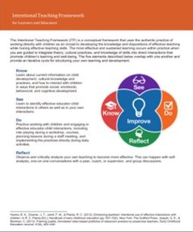
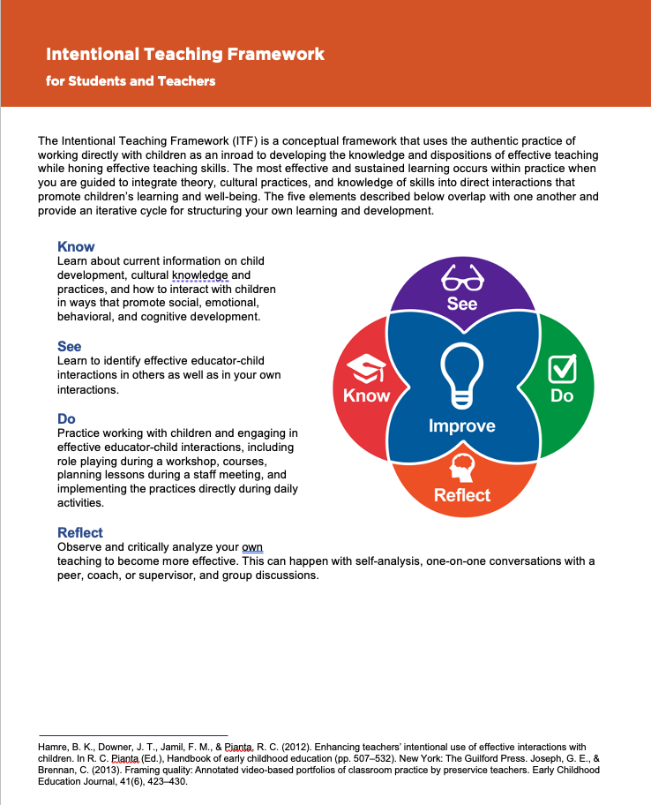
Crafting Learning Together
Review and Focus
Working Groups
Sharing and Feedback
Review ITF introduction
Review ITF Handout
Brainstorm focus for improvement
Form groups
Confirm group norms
Post each groups focus
Work in groups to complete handout
Post completed handouts
Solicit feedback
Positive observation
Connection to content
Alternative practice or Wonder
Encouragement
Notes:
Notes to Instructor: This is a suggestion for how you can use the ITF to help learners begin to understand how to use the framework to enhance their learning as educators. Providing an opportunity for learners to then reflect on what they create together can also deepen their learning. The ITF handout can be used in multiple ways by your learners and you may find it useful to plan your own coursework. Please feel free to adapt.
Review and Focus
Review ITF introduction: This can include posting the slides 1-11 on the LMS and having learners review together or on their own. The first two pages of the handout also provides a lot of information and may be enough review. Make sure to spend some time helping learners understand the elements of the framework before having them work together as a group to use it.
Review ITF Handout: Discuss how the handout uses a backward design – starting with a clear understanding of where we want to go and what we want to improve helps to ensure the other elements are aligned and will lead to improvement.
Brainstorm focus for improvement: As a whole group brainstorm specific teaching practices that they want to focus on. These can be drawn from your current course work (e.g. early math teaching skills like 'noticing and responding using math language') or from a tool you may be exploring (e.g. concept development from the Classroom Assessment Scoring System (CLASS). If the topics fall into categories (e.g. responsive caregiving, science), you can organize the brainstorm into them before creating groups.
Working Groups
Form groups: Each group should have at least two and no more than five learners. Decide if you will assign the groups or let them self-select depending on interest.
Confirm group norms: Have each group confirm what they need to be successful in working together (e.g. listening to each person, deciding on roles – note taker, facilitator, etc., asking each other questions, etc.). If you have already established norms in the course, you can use this time for them to identify anything else they may need while working together (e.g. need to leave my phone on because my child was not feeling well and I may get a call, patience with me because I didn't sleep well last night).
Post each group's focus for improvement.
Work in groups to complete handout: Provide some time limits to make sure they move along through the whole handout. You may have them go through the whole handout quickly and then go through it again to add on so they don't get stuck in one element. If a group is struggling with a specific element, help them brainstorm. Encourage them to use the work and content they are using in their coursework. This is not an exercise where they have to make up everything new, but is a way to help them frame the learning experience they may already be having.
Sharing and Feedback
You can have students post the completed handout online or in-person.
Solicit feedback: Before you have learners provide feedback to one another, have each group identify what they would like to get feedback on. If they post online they can include that with their post (e.g. "We were not sure how else we could 'see' this practice. Any ideas?"). Also, by this point in working together, learners should have practiced providing feedback and the instructor should have given them feedback on their feedback. Feedback should include:
Positive observations (e.g., "I like the way the group provided lots of different sources for 'know'"),
Connections to content (e.g., "We have discussed the importance of grounding science in the world around us, I see that the opportunities to 'see' include opportunities for observation of the environment")
Alternative practice (e.g., "You might want to include interviewing elders in the 'know')
Wonder: (e.g., "I wonder what else you might 'do' to practice emotional literacy")
Encouragement: (e.g., "This outline makes me want to leap into learning about mathematizing!")

Slide 17

Owning the ITF
Using the ITF to structure your own learning is a powerful way to strengthen your capacity as an early learning educator

Slide 18
Owning the Intentional Teaching Framework
Review ITF introduction
Review ITF Handout
Determine focus for improvement
Post each focus for improvement if shared
Work in groups or independently to complete individual handout
Submit and/or Implement
Notes:
Note to Instructor: This is a suggestion for helping learners 'own' their learning and see how they can use the framework throughout their teaching career to activate their own learning. This can be done as an assignment that learners work on independently, or they can work with others to draft their individual plan. This is an excellent way to prepare learners for student teaching or practicum where they can implement their plans and do the 'Do', 'Reflect' with their peers or mentors, and create opportunities to 'See' themselves by taking video or others through live observations. It is also a useful coaching tool. You may also use the ITF handout here by providing your learners with the Know, See, Reflect and Improve already completed and they brainstorm and implement the Do. Make it work for you and your learners.
Review ITF introduction: This can include posting the slides 1-11 on the LMS and having learners review together or on their own. The first two pages of the handout also provides a lot of information and may be enough review. Make sure to spend some time helping learners understand the elements of the framework before having them use it to plan their own learning.
Review ITF Handout: Reiterate how the handout uses a backward design – starting with a clear understanding of where we want to go and what we want to improve helps to ensure the other elements are aligned and will lead to improvement.
Determine focus for improvement: You can choose to brainstorm specific teaching practices that learners want to focus on, or you can determine the focus depending on your course work and the opportunities for application. These can be drawn from your current coursework (e.g. early math teaching skills like 'noticing and responding using math language') or from a tool you may be exploring (e.g. concept development from the Classroom Assessment Scoring System (CLASS). You may also offer a general category (e.g., Early Literacy) and have them choose a specific practice (e.g., vocabulary development during read-aloud).
Post each focus for improvement if shared: Having your learners share what they are focusing on can help develop affinity groups and can also help you make sure that a range of practices are being explored.
Work in groups or independently to complete the ITF handout: Again, even if this is an individual task or assignment, having learners collaborate on what and how they want to improve prepares them for the workforce where collaboration is key to being a successful professional.
Submit or Implement: You can decide how you want to structure this learning activity. Will it be something learners hand in that gets graded for completeness and alignment of the elements, or will it be a tool for them to then implement in their settings? By making it low-stakes and providing formative feedback yourself in a culture of inquiry, learners may more readily engage in the process and once familiar with it, use it repeatedly to enhance their learning.
Depending on the size of your group and the range of teaching practices explored, you will also end up with lots of fabulous strategies for creating more learning experiences for your learners!

Slide 19
Intentional Teaching Framework References
Grossman, P., Hammerness, M., & McDonald, M. (2009). Redefining teaching, re-imagining teacher education. Teachers and Teaching: Theory and Practice 15(2), 273–289.
Hamre, B., Downer, J., Jamil, F., & Pianta, R.C.. (2012). Enhancing teachers' intentional use of effective interactions with children: Designing and testing professional development interventions. Handbook of early childhood education. 507-532.
Joseph, G. & Brennan, C. (2013). Framing Quality: Annotated Video-Based Portfolios of Classroom Practice by Pre-service Teachers. Early Childhood Education Journal 41.
Lampert, M. (2010). Learning Teaching in, from, and for practice: What do we mean? Journal of Teacher Education, 61(1–2), 21–34. https://doi.org/10.1177/0022487109347321
McDonald, M., Kazemi, E., & Kavanaugh, S.S. (2013). Core practices and pedagogies of teacher education: A call for a common language and collective activity. Journal of Teacher Education 64 (5), 378-386
Sheridan, S. M., Edwards, C. P., Marvin, C. A., & Knoche, L. L. (2009). Professional development in early childhood programs: Process issues and research needs. Early Education and Development, 20(3), 377-401.
Sherin, B., & Star, J. (2011). Reflections on the study of teacher noticing. In M. G. Sherin, V. R. Jacobs, & A. Philipp (Eds.), Mathematics teacher noticing(pp. 66–78). Routledge.

