Slide 1
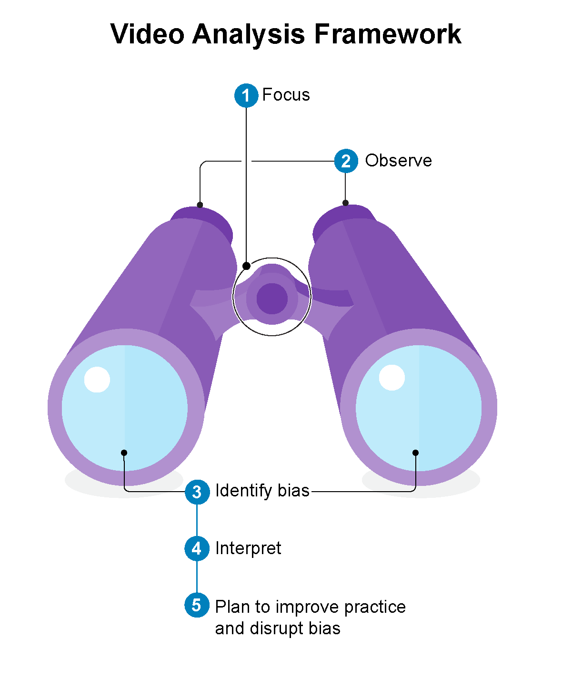
Using the Video Analysis Framework
An introduction and practice
Basket 2: Learning to See

Slide 2
Table of Contents
Section Title | Slides
Introduction to the Video Analysis Framework (VAF) | 4-15
2. Let’s Practice Using the VAF (Round 1–instructor-led practice) | 16-32
3. Working Together with the VAF (Round 2–small groups) | 33-39
4. Educator-Coach Role Play with the VAF (Round 3–role play) | 40-46
Notes:
Note to Instructors: There are four sections to this slide deck and represent four separate explorations and applications of the Video Analysis Framework (VAF).
Introduction to the Video Analysis Framework (slides 4-15): This section outlines the framework and each element so learners understand our approach to teaching practice-based learning in early childhood. By providing explicit guidance to engage in this approach to learning, learners can own more of their learning process. This guidance also motivates them to acquire the skills effective teaching requires. You can provide this section of the slide deck to your learners ahead of class so you can spend more time discussing the various elements and answering any questions.
Let’s practice using the VAF (slides 16-32): This section suggests instructors guide learners step-by-step through the Video Analysis Framework. A specific teaching practice is provided as the focus of analysis.
Working together with the VAF (slides 33-39): This section suggests increasing learner autonomy by having small groups use the VAF to analyze a video related to a specific teaching practice that is provided to them (focus). By having students do this together, we leverage the power of collective thinking.
Role play with the VAF (slides 40-46): This section suggests using the VAF in pairs as a role-play exercise. One learner will take on the role of the educator, and one will take on the role of the coach. In the educator role, participants share their focus, observations and interpretations, while also reflecting on potential biases. In the coach role, participants provide feedback to the educator, which is an opportunity for learners to use what they learned in Basket 1 about providing feedback and apply it to the VAF.
While all these activities focus on having the learners explore and develop their own understanding of the Video Analysis Framework, we invite instructors to use the VAF handout and these slides to craft their own practice-based course work.

Slide 3
Basket 2 Learning Outcomes
Introduction to the Video Analysis Framework (VAF): Learners will explore the elements of the framework and be able to explain how the elements work together to support effective teaching.
Let’s Practice Using the VAF (Round 1-instructor led): Learners will practice using the framework as a whole group with the Instructor.
Working Together with the VAF (Round 2-small groups): Learners will practice in small groups using the framework with a focus provided by the Instructor.
Educator-Coach Role Play with the VAF (Round 3-role play): Learners will work in pairs, choose the focus of their practice, and take on the role of educator and coach in the videos they select.
Notes:
You may choose to put the slides for the Introduction into your LMS (with or without discussion) and have learners explore prior to synchronous class meeting time and then start your synchronous class with 2. Let’s Practice
Estimated times:
Introduction to the Video Analysis Framework: 20-30 min
Let’s Practice Using the Visual Analysis Framework: 60 min
Working Together with the VAF: 60 min
Educator-Coach Role Play with the VAF: Depending on your approach and if learners have watched the content videos ahead of time (recommended). At least 30 minutes for each role (60 min total) and possibly longer.

Slide 4
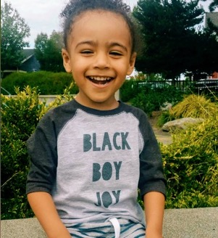
Community Agreements
Stay engaged
Speak your truth
Listen to understand
Keep confidentiality
Ask for help
Support one another
Notes:
Presenter Notes:
Let’s review the community agreements we have created. This is a reminder that we all agree to stay engaged, speak your truth, listen to understand, keep confidentiality, ask for help when you need to, and support one another.
Is there anything you would like to add, or is there anything you need today to make you a successful learner?
Make sure to always ask, in addition to checking in on these standing agreements:
“Is there anything else you need during this time together?”
This allows someone who might have a plumber, etc. coming during this time to let everyone know they may need to step away or turn their camera off. Another example could be a parent who has a child who may be calling home sick from school. We want to make sure the community feels safe and held.
These are just suggested agreements. We recommend that you create a list with your group of learners at the start of each term and revisit in each class session. You can copy this slide and paste into the start of each of the sections.

Slide 5
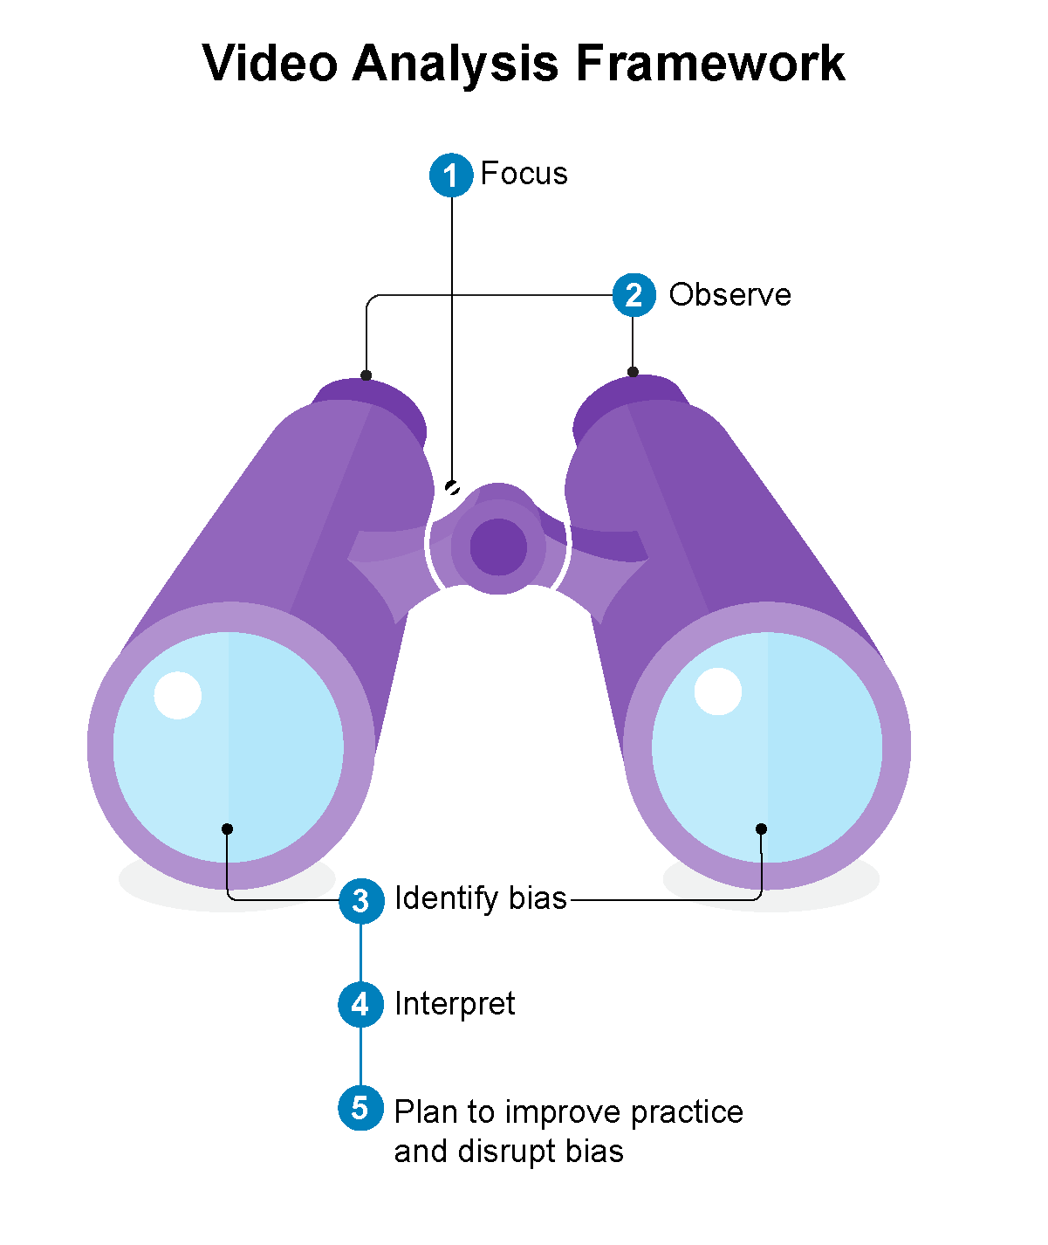
Introduction to the Video Analysis Framework
What is going on here?​
What do you see that tells you that?​
What else do you notice?
Notes:
NOTE TO INSTRUCTOR:
The information in this presentation about the Video Analysis Framework comes from the following article:
Packard, M. Brennan, C. Joseph, G., Emerson-Hoss, K. (2021). The power of video analysis: Developing
professional vision and anti-bias practices for pre- and in-service teachers. Young Children, 77(1) https://
www.naeyc.org/resources/pubs/yc/spring2022
The article is not publicly available, but it is accessible to NAEYC members.
INTRODUCE THE FRAMEWORK
Ask learners about what they notice
Pictured on the slide is the Video Analysis Framework, or VAF. Based on what you see in the picture, what do you think are some of its defining features and how does it work?
Possible answers:
Learners may notice that each component of the Framework is numbered, so there must be a specific order in which you follow the steps. They may also point out the word “Video” in the title and how that is an essential tool for using the framework. Learners could note that “Observe” and “Interpret” are two separate steps on opposite sides of the binoculars; Observe comes first before any interpretations are made. Learners may also notice and point out the role of bias.

Slide 6
Professional Vision
How was it the last time you were in an early learning setting, or with a group of young children? Recall the sights and sounds that capture it in detail.
Notes:
PROFESSIONAL VISION
The Video Analysis Framework (VAF) supports educators’ professional vision. To understand professional vision, remember the last time you were in an early learning setting, or with a group of young children. Recall all the sights and sounds of that environment.
NOTE TO INSTRUCTOR: Pause to allow learners to recall what it was like the last time they were in an early learning setting. Then, ask them to share.
How was it the last time you were in an early learning setting, or with a group of young children? Describe the sights and sounds that capture it in detail.
You may notice something similar about all our descriptions–early learning environments are busy places! They are especially complex and constantly shifting.
When educators develop professional vision, they can closely notice and reason about children’s thinking and behavior, even amongst all the hustle and bustle of an early learning setting. They can be flexible and respond to what is happening in the moment using their knowledge of developmentally appropriate practice (NAEYC, 2020) and anti-bias education (Derman-Sparks & Edwards, with Goins, 2020).
Using video is a great way to practice developing professional vision because you can capture exactly what happened in the moment, pause to notice different behaviors and interactions, and rewatch the video multiple times. Once you’re comfortable analyzing video of other educators’ teaching practices using the VAF, you can use it to reflect on your own teaching.
There are five skills in the Video Analysis Framework that we will discuss in detail on the following slides:
Focus
Observe
Identify bias
Interpret
Plan to improve practice and disrupt bias
References
Derman-Sparks, L., J.O. Edwards, & C.M. Goins (2020). Anti-bias education for young children & ourselves. Washington D.C.: NAEYC.
NAEYC (2020). Developmentally appropriate practice position statement. https://www.naeyc.org/resources/position-statements/dap/contents

Slide 7
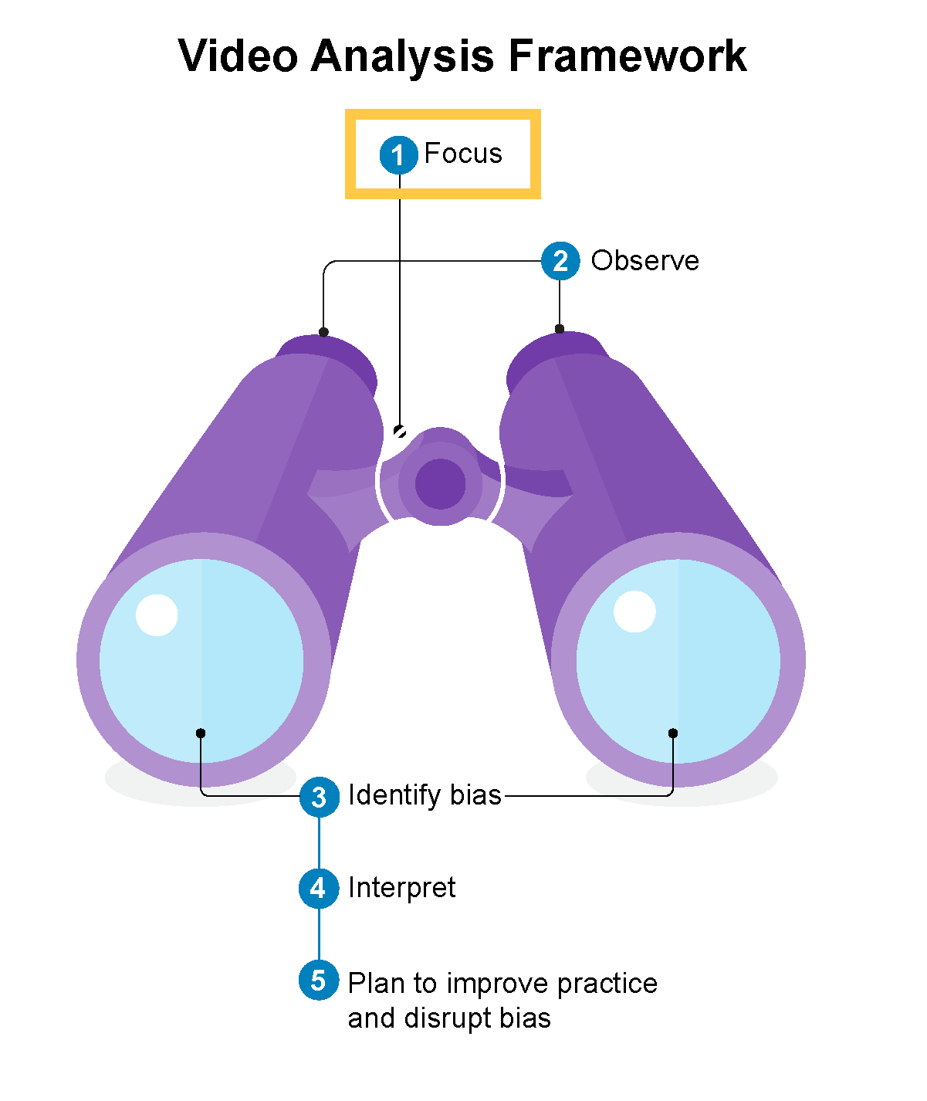
Focus
Related to course concepts, cultural practices, or professional development goals
Specific and clearly defined
Notes:
Since early learning environments are often busy places with many things happening at once, it’s important to begin by selecting a focus. In other words, what will you specifically pay attention to while allowing everything else to remain in the background and out of view? Think of selecting a focus like using a pair of binoculars. Once you adjust the focus wheel and look through the lenses, you’re looking closely and clearly at one specific thing.
A focus usually relates to concepts you are learning about (such as building emotional vocabulary) or your own professional development goals (such as a desire to improve your teaching when it comes to transitions between activities). The most important thing is that the focus for your reflection and analysis is clearly defined and specific.

Slide 8
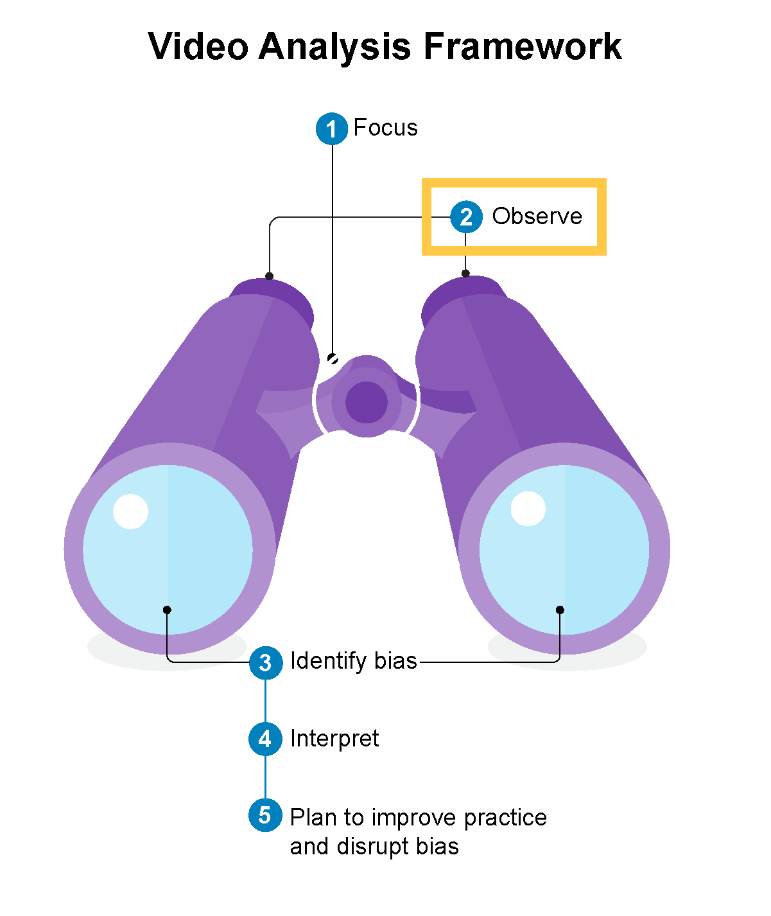
Observe
Making descriptive, behavioral, and specific observations about child development and interactions between educators and children
Notes:
The second skill is observation. This is related to the skills you have already practiced in Basket 1: Visual Thinking Strategies’ second question of ‘What do you see that tells you that?’ The intent in the observation portion is to make descriptive, behavioral, and specific observations about child development and interactions between educators and children. It is objectively noticing and describing what is going on without inserting your own opinions, judgements, or emotional reactions. What is it we see through the first lens of the binoculars?

Slide 9
Observation Examples
Example 1:
“At video timestamp 5:32, the educator gets down on the child’s level, makes eye contact with them, and asks if they would like to read a book. The child responds by nodding and sitting down in the educator’s lap.”
Example 2:
“I like how the educator approaches the child to read a book. The child is excited to read with her.”
Notes:
Here are two examples of observations. Which one is descriptive, behavioral, and specific? Why?
Answer: Example 1 is descriptive, behavioral, and specific. The observation includes a specific timestamp where the interaction occurred. It describes specific behaviors (educator gets down on the child’s level, educator makes eye contact with child, child nods, child sits in educator’s lap).
Example 2 is not descriptive, behavioral, and specific. It states an opinion and assumes how the child was feeling.
Note: It is important to reinforce that the second example is not WRONG, it just isn’t a useful observation. And we almost always start with making these inferences when observing. It is human nature. Being able to provide descriptive, behavioral, and specific language without leaping to inferences is a learned skill that takes practice.

Slide 10
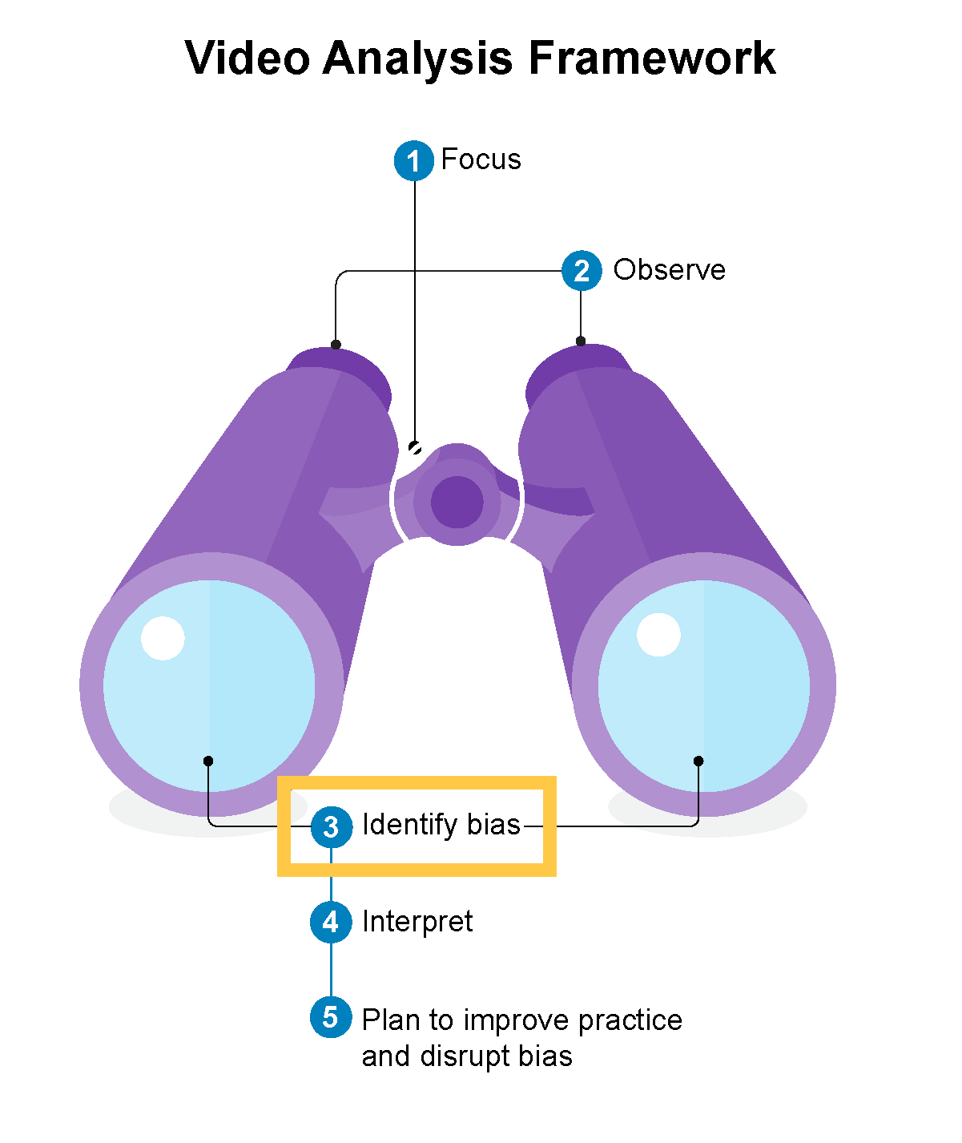
Identify bias
Biases are always present, we all have some, and they impact professional vision
By identifying bias, we can disrupt it
Notes:
The third skill in the Video Analysis Framework is identifying bias. As our vision travels out of the end of the binoculars, it is colored by our lens of bias. This is especially important to reflect on and identify because systemic oppression and personal biases (both implicit and explicit) are always present. Biases impact what we choose to focus on, what we observe, and how we interpret those observations. By intentionally pausing to identify biases BEFORE we interpret what we see and plan for improvement can help to disrupt the bias through more accurate and valid interpretations, and more effective and reliable plans.

Slide 11
Exploring Bias
How do my culture, personal beliefs, values, and biases relate to structural inequities and their impact on children and families over time?
What specific aspects of my background may impact my assumptions about children and families as I build relationships?
When I become aware of a biased action, am I willing to take responsibility, use the opportunity to learn and reflect, resist becoming defensive, and repair the harm?
What other questions might you ask?
Notes:
There are many questions we can explore to become more self-aware about our biases. Here are a few inspired by NAEYC’s Advancing Equity in Early Childhood Education Position Statement (2019):
How do my culture, personal beliefs, values, and biases relate to structural inequities and their impact on children and families over time?
What specific aspects of my background may impact my assumptions about children and families as I build relationships?
When I become aware of a biased action, am I willing to take responsibility, use the opportunity to learn and reflect, resist becoming defensive, and repair the harm?
What other questions might you ask?
Reference: National Association for the Education of Young Children (2019). Advancing equity in early childhood education position statement. https://www.naeyc.org/resources/position-statements/equity

Slide 12
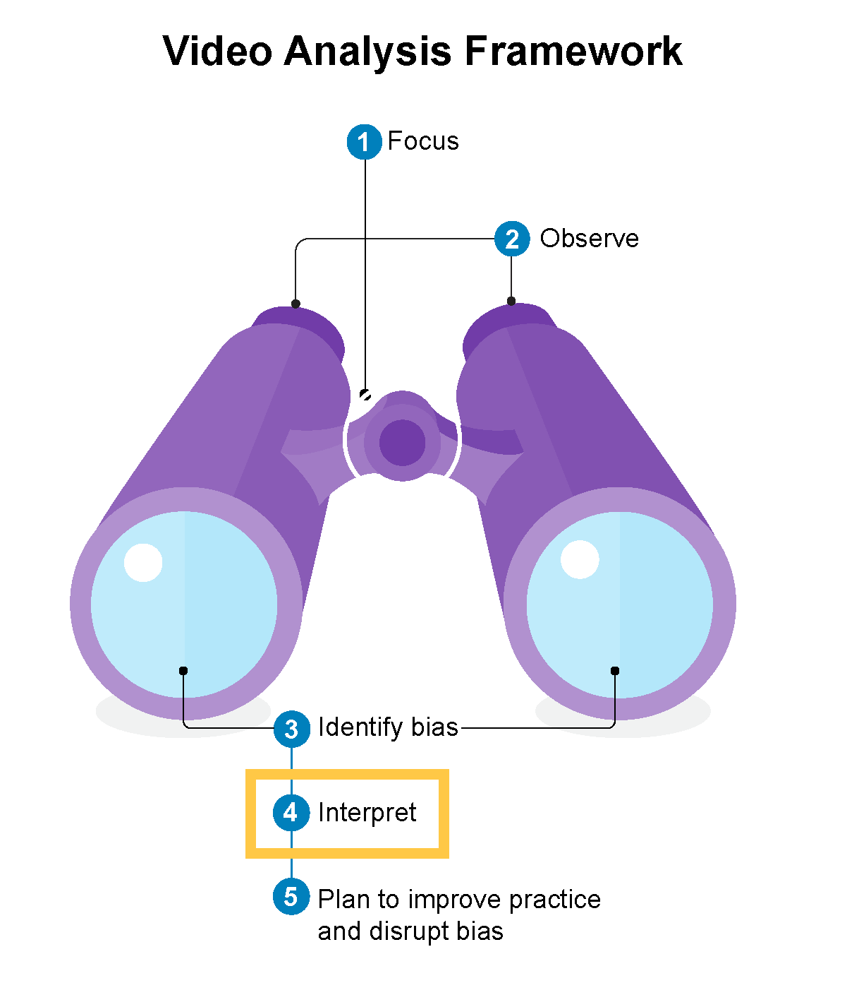
Interpret
Use observations as evidence for interpretations
Take a strengths-based approach
Propose alternative practices that may have better supported children
Notes:
The fourth skill is interpret. This is when you take what you observed and use it as evidence to make responsive teaching decisions. It is where we connect what we see to what we know about the specific children and teachers, general child development, cultural practices, and teacher-child interactions. Ideally, our interpretations are as free of bias as possible, so we are not wrongly assuming something about the children or the interactions (e.g. “He doesn’t care about washing the baby dolls” may reflect a bias about boys not being caretakers). Additionally, when interpreting the impact of specific teaching practices, we take a strengths-based approach. We notice what educators did well and the positive impact it had on children. This is also an opportunity to propose alternative practices related to the focus that may have better supported children.

Slide 13
Sample Interpretation
“At the video timestamp 5:37, I ask Michael an open-ended question because I am trying to prompt him to use the facts that we just read in the book to make a prediction. ‘What do you think will happen when he moves into the neighborhood?’ Michael doesn’t respond, and then I ask a closed question, ‘Do you think the four of them will be friends?’ He says, ‘yes’; I answer, ‘I think so, too’ and close the book. My first question was strong, and I wonder if, after his silence, I should have instead pointed back to specific information in the story like, ‘What happened the last time someone new moved into the neighborhood?’ Would that have supported him to create and explain a prediction himself?”
Source: Packard, M., Brennan, C., Joseph, G.E., & Emerson-Hoss, K. (2022). The power of video analysis: Developing professional vision and anti-bias practices for pre- and in-service teachers. Young Children.
Notes:
NOTE TO INSTRUCTOR: Read the sample interpretation aloud or ask for a volunteer to read it.
This is an example of what an interpretation might sound like. What makes this a strong example?
(If needed, go back to the previous slide so learners can review the key elements of making an interpretation.)
Possible answers: The interpretation is based upon specific behavioral observations that were made about what happened as the educator read a book with Michael. There is a strengths-based component where the educator points out the success of their first question. There is a suggestion for an alternative practice that may have worked better to encourage Michael to make a prediction.

Slide 14
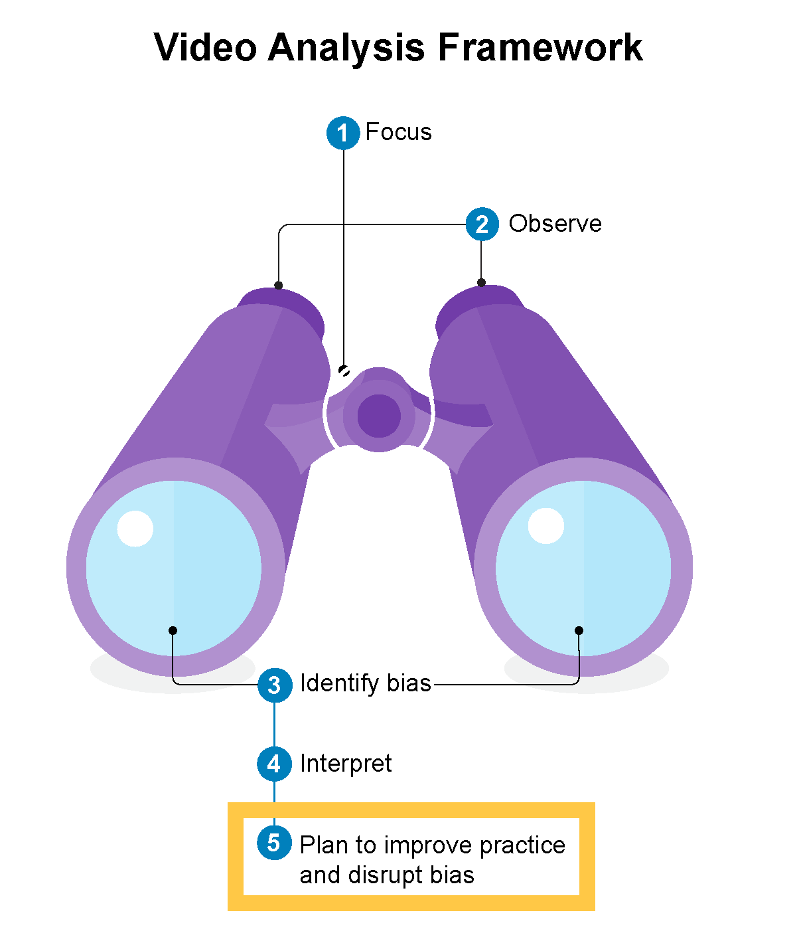
Plan to Improve and Disrupt Bias
Specific things educators will do to improve their teaching in the future and disrupt bias
Based on observations, identified biases, and interpretations
Notes:
The fifth and final skill is plan to improve practice and disrupt bias. This is when educators identify specific things they will do to improve future practice and disrupt bias based on their observations, identified biases, and interpretations.
For example, let’s say an educator is focused on using wait time during read aloud to the whole class. One observation after watching a video of a read aloud session was that the educator waited for five seconds or less after asking a question about the book. While two or three students consistently raised their hands in this time frame, the rest of the children were sitting quietly and looking at the book. Therefore, part of the educator’s plan to improve practice may be to place a sticky note on each page where he will ask a question with the words “Wait 10 seconds” written underneath the question as a reminder.
When the educator looked back at the video of their interactions with an eye toward understanding what biases might be at play, the educator paid attention to the differences in their interactions with boys and girls. The educator noticed he called on boys more often to answer questions and, after calling on them, gave them more time to respond. So, another part of his plan to improve may be to alternate calling on boys and girls, or to use the class list to keep track of who he is calling on, and to slowly count to five in his head each time he calls on a child to respond to a question. He further decides to share this with the children “I have noticed that I don’t always give everyone enough time to respond to my questions. Will you help me remember? I am going to count to 5 in my head after I call on you and if you need more time you can give me a hand signal.”

Slide 15
Pulling it All Together
How do you understand the Video Analysis Framework (VAF)?
How might this be useful for you as an educator?
How might the VAF help you understand some of the learning experiences you have already had?
What elements of this framework might have been missing that could strengthen your learning about teaching?
What else do you wonder about?
Notes:
Note for instructor: This is an opportunity to check learners' understanding of the VAF and how the pieces work together. You can ask learners to define each element and to brainstorm some examples of how they imagine this might look in practice.
Questions:
How do you understand the Video Analysis Framework (VAF)?
How might this be useful for you as an educator?
How might the VAF help you understand some of the learning experiences you have already had?
What elements of this framework might have been missing that could strengthen your learning about teaching?
What else do you wonder about?

Slide 16
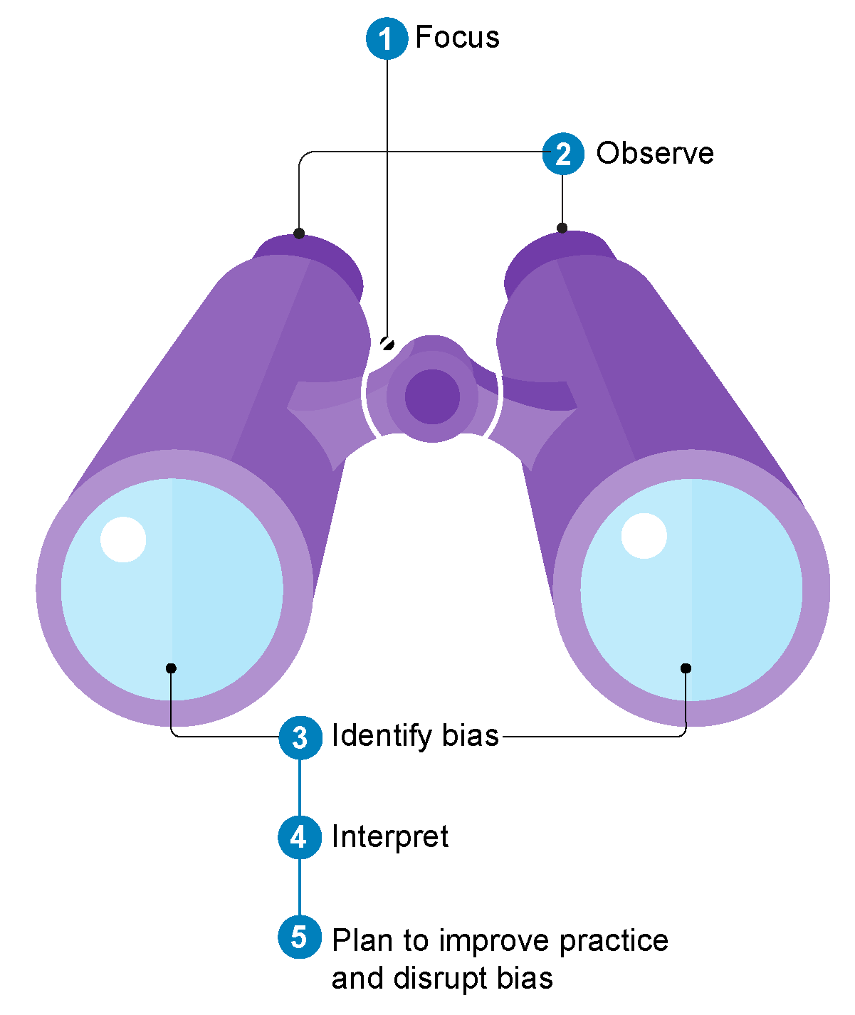
Let’s Practice Using the Visual Analysis Framework (VAF)
Notes:
Round #1: Slides 16-32 provides guided whole group practice using the VAF to analyze videos of teacher-child interactions with a focus on Emotional Literacy. The materials from the Mini-Lessons provided in Basket 2 are used in this section. You can choose to swap out a different focus depending on the demands of your course work. There are nine mini-lessons provided, and you are free to use your own content focus.
This section of the deck includes all the Introduction slides and then application slides for practicing each skill.
Time:
Let’s Practice Using the Visual Analysis Framework: 60 min

Slide 17
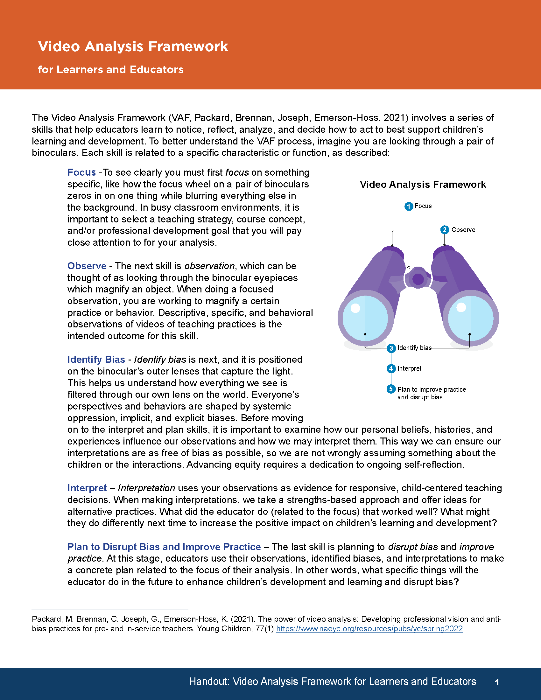
Learning Outcomes: Let’s Practice Using VAF
Learners will practice using the VAF as a whole group.
Learners will use the focus of emotional literacy to analyze video.
Learners will provide specific, descriptive, and behavioral observations with selected video.
Learners will consider their own biases as observers and what may be present for the teacher in the video.
Learners will interpret the video in relation to the focus of emotional literacy.
Learners will suggest plans to uncover and disrupt bias and improve practice.
Notes:
Please amend the objectives to the fit your content focus if you choose another one other than emotional literacy.
Additionally, you may choose to use the handout provided in this section to help learners practice using it when they work together in small groups and in the Educator-Coach Role Play.
We have included all the introduction section slides in this section as well. Feel free to adapt as needed.

Slide 18
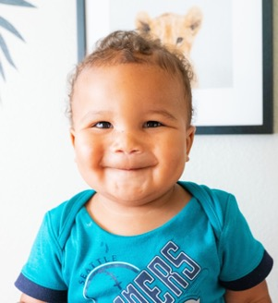
Community Agreements
Stay engaged
Speak your truth
Listen to understand
Keep confidentiality
Ask for help
Support one another
Notes:
Presenter Notes:
[Allow 2–3 minutes for this activity.]
As a reminder, we are a community of learners who are invested in our own and one another’s learning and who draw from our peers as a source of learning, too. Reviewing our community agreements, which we created during the first live session, I’d like to remind everyone that we agree to stay engaged, speak your truth, listen to understand, keep confidentiality, and ask for help when you need to.
Is there anything you would like to add, or is there anything you need today to make you a successful learner?
Note: Make sure to always ask, in addition to checking in on these standing agreements,
“Is there anything else you need during this time together?”
This allows someone who might have a plumber coming during this time to let everyone know ahead of time that they may need to step away or turn their camera off. Another example could be a parent who has a child who may be calling home sick from school. We want to make sure the community feels safe and held.

Slide 19
Focus
Related to course concepts, cultural practices, and/or professional development goals
Specific and clearly defined
Notes:
Since early learning environments are often busy places with many things happening at once, it’s important to begin by selecting a focus. In other words, what will you specifically pay attention to while allowing everything else to remain in the background and out of view? Think of selecting a focus like using a pair of binoculars. Once you adjust the focus wheel and look through the lenses, you’re looking closely and clearly at one specific thing.
A focus is usually related to concepts you are learning about, such as building emotional vocabulary, or your own professional development goals, such as a desire to improve your teaching when it comes to transitions between activities. The most important thing is that the focus for your reflection and analysis is clearly defined and specific.

Slide 20
Focus: Supporting Emotional Literacy
Watch this 10-minute video about the Importance of Emotional Literacy
Follow the prompt to generate a list of 10 feeling words beyond happy, sad, and mad (time stamp 0:24)
Code your list + positive or – negative as directed in the video (time stamp 3:45-4:20)
Discussion
  Questions?
  Reactions?
  Experience?
Mini-Lesson: Supporting Emotional Literacy
Notes:
To practice this skill:
You may choose to provide this slide and videos with its activity to learners prior to class meeting to help focus time together on analysis and discussion. You can use the vocabulary lists to generate a class emotional vocabulary list too.
This material is taken from the mini lesson: Emotional Literacy which can be found in the LMS or using the link on the slide.
It can be useful for your learners who may also be educators with classrooms of their own to provide examples of how they do this in their classrooms of if they have any ideas about how they might implement.
-------
Since early learning environments are often busy places with many things happening at once, it’s important to choose a focus first. In other words, what will you specifically pay attention to while allowing everything else to remain in the background and out of view? Think of selecting a focus like using a pair of binoculars. Once you adjust the focus wheel and look through the lenses, you’re looking closely and clearly at one specific thing.
A focus is usually related to concepts you are learning about, such as building emotional vocabulary, or your own professional development goals, such as a desire to improve your teaching when it comes to transitions between activities. The most important thing is that the focus for your reflection and analysis is clearly defined and specific.

Slide 21
Observe
Making descriptive, behavioral, and specific observations about child development and interactions between educators and children
Notes:
The second skill is observation. This is related to the skills you have already practiced in Basket 1: Visual Thinking Strategies’ second question of ‘What do you see that tells you that?’ The intent in the observation portion is to make descriptive, behavioral, and specific observations about child development and interactions between educators and children. It is objectively noticing and describing what is going on without inserting your own opinions, judgements, or emotional reactions. What is it we see through the first lens of the binoculars?

Slide 22
Observation: Supporting Emotional Literacy
Watch this video Practice in Action: How Did You Feel? (1:49)
Take notes about where you see the educator supporting emotional literacy (the focus).
Watch the video again and add to your notes.
Notes should include specific description of behaviors.
Watch the video one more time and take more notes.
Pair and Share observations providing each other formative feedback on their observations.
Have a few learners volunteer to share with whole group and make sure they include specific descriptions of behaviors and interactions.
Mini-Lesson: Supporting Emotional Literacy
Notes:
To practice this skill:
Total time for this is 20- 30 minutes depending on the experience and skill of your learners. It is essential to make sure they understand descriptive, specific, and behavioral. Time spent on this skill will be invaluable as they move along in the profession. You may choose to display the next slide (Observation Examples) as a reminder before watching video.
You may choose to provide this slide and videos with its activity to learners prior to class meeting to help focus time together on analysis and discussion. If you are meeting on subsequent days, you can provide the focus and content videos for homework and discuss in class and then provide the Practices in Action videos for them to watch on their own at least once before coming to class. You cannot watch a video too many times.
For Pair and Share
You may choose to display the observation examples
remind learners to provide feedback to one another that includes:
Positive observation (e.g., You did a great job describing the child reaching and talking)
Connection to content (e.g., You highlighted the incidental teaching that was talked about in the instructional video)
Suggestions for alternate practice (e.g., I wonder if it would help to change your statement of ‘he was bored’ to ‘he kept looking away’)
Encouraging end (e.g., Hearing your observation made me feel like I was there)
Practicing this structure for feedback will help learners and educators when they are sharing videos of their own practice. The learning activity in Basket 1: Providing Feedback is a good prior activity and reminder.
This material is taken from the mini lesson: Emotional Literacy which can be found in the LMS or using the link on the slide.
-----
The second skill is observation. This is related to the skills you have already practiced in Basket 1: Visual Thinking Strategies’ second question of ‘What do you see that tells you that?’ The intent in the observation portion is to make descriptive, behavioral, and specific observations about child development and interactions between educators and children. It is objectively noticing and describing what is going on without inserting your own opinions, judgements, or emotional reactions. What is it we see through the first lens of the binoculars?

Slide 23
Observation Examples
Example 1:
“At video timestamp 5:32, the educator gets down on the child’s level, makes eye contact with them, and asks if they would like to read a book. The child responds by nodding and sitting down in the educator’s lap.”
Example 2:
“I like how the educator approaches the child to read a book. The child is excited to read with her.”
Notes:
You can put this slide up for the pairs when they are sharing their observations to help them refine their observations. You may also choose to show this slide before starting to watch the videos as a reminder.
----
Answer: Example 1 is descriptive, behavioral, and specific. The observation includes a specific timestamp where the interaction occurred. It describes specific behaviors (educator gets down on the child’s level, educator makes eye contact with child, child nods, child sits in educator’s lap).
Example 2 is not descriptive, behavioral, and specific. It states an opinion and assumes how the child was feeling.
Note: It is important to reinforce that the second example is not WRONG, it just isn’t a useful observation. And we almost always start with making these inferences when observing. It is human nature. Being able to provide descriptive, behavioral, and specific language without leaping to inferences is a learned skill that takes practice.

Slide 24
Identify Bias
Biases are always present, we all have some, and they impact professional vision
By identifying bias, we can disrupt it
Notes:
The third skill in the Video Analysis Framework is identifying bias. As our vision travels out of the end of the binoculars, it is colored by our lens of bias. This is especially important to reflect on and identify because systemic oppression and personal biases (both implicit and explicit) are always present. Biases impact what we choose to focus on, what we observe, and how we interpret those observations. By intentionally pausing to identify biases BEFORE we interpret what we see and plan for improvement can help to disrupt the bias through more accurate and valid interpretations, and more effective and reliable plans.
For this section, learners will first reflect on their own biases as they watch the educator in the practice video and then consider what biases she may have based on what they see. Again, as learners reflect on the teachers’ potential biases, it is important that learners can specifically identify ‘what they see that tells them that’

Slide 25
Exploring Bias
How do my culture, personal beliefs, values, and biases relate to structural inequities and their impact on children and families over time?
What specific aspects of my background may impact my assumptions about children and families as I build relationships?
When I become aware of a biased action, am I willing to take responsibility, use the opportunity to learn and reflect, resist becoming defensive, and repair the harm?
What other questions might you ask?
Notes:
To practice this skill:
If you and your learners have already discussed this slide in the Introduction to Video Analysis Framework section, here you can let them know they will be reflecting on both their own biases that may come into play when watching the educator and children AND wondering about the educator in the video’s potential bias.
If you have not discussed this slide, lead a discussion around the questions and then go into what they are doing next (considering their and the educator-in-video’s bias)
------
There are many questions we can explore to become more self-aware about our biases. Here are a few inspired by NAEYC’s Advancing Equity in Early Childhood Education Position Statement (2019):
How do my culture, personal beliefs, values, and biases relate to structural inequities and their impact on children and families over time?
What specific aspects of my background may impact my assumptions about children and families as I build relationships?
When I become aware of a biased action, am I willing to take responsibility, use the opportunity to learn and reflect, resist becoming defensive, and repair the harm?
What other questions might you ask?
Reference: National Association for the Education of Young Children (2019). Advancing equity in early childhood education position statement. https://www.naeyc.org/resources/position-statements/equity

Slide 26
Exploring Bias: Supporting Emotional Literacy
Watch video again: Practice in Action: How Did You Feel?
Your own biases
Educator-in-video’s potential bias
What did you feel watching the video?
Are there any specific beliefs or aspects of your experience that impact your assumptions about the children, the educator, and/or the classroom environment?
What do you believe or think about feelings and gender? (e.g., Boys don’t cry)
How might you check your bias and not have it affect your interpretations?
What other questions might you ask yourself?
What do you wonder about the Educator’s potential bias?
What questions would you want her to ask herself?
How might she discover any biases she might have
Notes:
To practice this skill:
We encourage you to watch the video, Practices in Action: How Did You Feel?, again before engaging in the discussion.
Since reflecting on and sharing our biases may be uncomfortable it is important to remind learners of the community agreements and make sharing in the group voluntary. You may also have student journal responses to these questions before having a whole group discussion. This can help them formulate their own thoughts and before sharing and being influenced by others’ thoughts and reactions.
It is also essential to model respect, compassion, and grace for the educators in the classroom videos you watch together. This is critical for establishing the safety learners will need to feel when sharing videos of their own practice.
-----
There are many questions we can explore to become more self-aware about our biases. Here are a few inspired by NAEYC’s Advancing Equity in Early Childhood Education Position Statement (2019):
How do my culture, personal beliefs, values, and biases relate to structural inequities and their impact on children and families over time?
What specific aspects of my background may impact my assumptions about children and families as I build relationships?
When I become aware of a biased action, am I willing to take responsibility, use the opportunity to learn and reflect, resist becoming defensive, and repair the harm?
What other questions might you ask?
Reference: National Association for the Education of Young Children (2019). Advancing equity in early childhood education position statement. https://www.naeyc.org/resources/position-statements/equity

Slide 27
Interpret
Use observations as evidence for interpretations
Take a strengths-based approach
Propose alternative practices that may have better supported children
Notes:
The fourth skill is interpret. This is when you take what you observed and use it as evidence to make responsive teaching decisions. When interpreting the impact of specific teaching practices, we take a strengths-based approach. We notice what educators did well and the positive impact it had on children. This is also an opportunity to propose alternative practices related to the focus that may have better supported children.

Slide 28
Interpret: Supporting Emotional Literacy
Based on the observations we have shared and the biases we have reflected on, what are our interpretations related to our Focus?
How does what we observed connect to what we know about supporting emotional literacy?
How do we see the effect or impact on children and their development?
What alternative supporting emotional literacy practice might we suggest?
Instructional Video | Practice Video
Importance of Emotional Literacy (10:00) | Practice in Action: How Did You Feel? (1:49)
Notes:
To practice this skill:
Learners will reflect on the instructional video Importance of Emotional Literacy and apply the knowledge they gather from that to the Practice in Action: How Did You Feel? Video. You can choose to show these in class or send them ahead of time. Since both videos have been viewed already, you can just make sure your learners have access to the links (in the LMS, texted, or emailed) so they can watch them as they need to for this exercise.
Suggested process (30 min) (this is a drafting and cumulative exercise. By the end the whole group will have a solid interpretation. So it is not necessary to provide enough time for full video review or full independent drafting:
Provide learners with link to videos and give them 5-7 min to review both. Not necessary to provide full time to watch both fully.
Have learners draft their own interpretations (5 min) Not important to be complete, but to have various elements
Pair and share and work with partner to refine an interpretive statement (10 minutes)
Whole group (10 min depending on size of group):
Ask for volunteer to offer their interpretation to get started
Write it on board where full group can see
Ask for additional interpretations
Write them down too and consolidate where it makes sense asking for confirmation from learners that it still meets their intent
Continue until no one else offers additions and amendments
Ask group to evaluate the quality of the interpretation – is it clear? Is it specific about behavior and the video? Is it connected to the content? Does it include alternative practices?
You can use the following slide Sample Interpretation to evaluate final interpretation or to leave on screen while learners are working
---
The fourth skill is interpret. This is when you take what you observed and use it as evidence to make responsive teaching decisions. When interpreting the impact of specific teaching practices, we take a strengths-based approach. We notice what educators did well and the positive impact it had on children. This is also an opportunity to propose alternative practices related to the focus that may have better supported children.

Slide 29
Sample Interpretation
“At the video timestamp 5:37, I ask Michael an open-ended inferential question because I am trying to prompt him to use the facts we just read to make a prediction. ‘What do you think will happen when he moves into the neighborhood?’ Michael doesn’t respond, and then I ask a closed question, ‘Do you think the four of them will be friends?’ He says, ‘yes’; I answer, ‘I think so, too’ and close the book. My first question was strong, and I wonder if, after his silence, I should have instead pointed back to specific information in the story like, ‘What happened the last time someone new moved into the neighborhood?’ Would that have supported him to create and explain a prediction himself?”
Source: Packard, M., Brennan, C., Joseph, G.E., & Emerson-Hoss, K. (2022). The power of video analysis: Developing professional vision and anti-bias practices for pre- and in-service teachers. Young Children.
Notes:
You may choose to delete this slide, show this slide while learners are working, and/or use it to evaluate the group interpretation
NOTE TO INSTRUCTOR: Read the sample interpretation aloud or ask for a volunteer to read it.
This is an example of what an interpretation might sound like. What makes this a strong example?
(If needed, go back to the previous slide so learners can review the key elements of making an interpretation.)
Possible answers: The interpretation is based upon specific, behavioral observations that were made about what happened as the educator read a book with Michael. There is a strengths-based component where the educator points out the success of their first question. There is a suggestion for an alternative practice that may have worked better to encourage Michael to make a prediction.

Slide 30
Plan to improve and disrupt bias
Specific things educators will do to improve their teaching in the future and disrupt bias
Based on observations, identified biases, and interpretations
Notes:
The fifth and final skill is plan to improve practice and disrupt bias. This is when educators identify specific things they will do to improve future practice and disrupt bias based on their observations, identified biases, and interpretations.
For example, let’s say an educator is focused on using wait time during read aloud to the whole class. One observation after watching a video of a read aloud session was that the educator waited for five seconds or less after asking a question about the book. While two or three students consistently raised their hands in this time frame, the rest of the children were sitting quietly and looking at the book. Therefore, part of the educator’s plan to improve practice may be to place a sticky note on each page where he will ask a question with the words “Wait 10 seconds” written underneath the question as a reminder.
During the process of observation, interpretation, and identifying biases, the educator also noticed he called on boys more often to answer questions and, after calling on them, gave them more time to respond. So, another part of his plan to improve may be to alternate calling on boys and girls, and to slowly count to five in his head each time he calls on a child to respond to a question.

Slide 31
Plan to Improve and Disrupt Bias: Supporting Emotional Literacy
What specific things could the educator do to improve their teaching and disrupt bias?
How does the plan connect to the observations, identified biases, and interpretations?
Notes:
To practice this skill:
Lead a discussion with the class to develop a plan for disrupting bias and improving practice. This may include strategies to uncover bias (e.g., collecting data on who the educator talks to and how). Since they are NOT the educators in the video, it would be useful to identify ways they might uncover their own biases.
If in the earlier exercise you have posted a ‘class’ observation and interpretation from their sharing out, asking questions that connect directly to the focus, observations, and interpretations in an explicit manner will help tie all the skills together.
----
The fifth and final skill is plan to improve practice and disrupt bias. This is when educators identify specific things they will do to improve their practice and disrupt bias based on their observations, identified biases, and interpretations.
For example, let’s say an educator is focused on using wait time during read aloud to the whole class. One observation after watching a video of a read aloud session was that the educator waited for five seconds or less after asking a question about the book. While two or three students consistently raised their hands in this time frame, the rest of the children were sitting quietly and looking at the book. Therefore, part of the educator’s plan to improve practice may be to place a sticky note on each page where he will ask a question with the words “Wait 10 seconds” written underneath the question as a reminder.
During the process of observation, interpretation, and identifying biases, the educator also noticed he called on boys more often to answer questions and, after calling on them, gave them more time to respond. So, another part of his plan to improve may be to alternate calling on boys and girls, and to slowly count to five in his head each time he calls on a child to respond to a question.

Slide 32
Pulling it All Together
How would you describe the Video Analysis Framework (VAF)?
How might this be useful for you as an educator?
How might the VAF help you understand some of the learning experiences you have already had?
What elements of this framework might have been missing that could strengthen your learning about teaching?
What else do you wonder about?
Notes:
Note for instructor: This is an opportunity to check learners' understanding of the VAF and see if any new knowledge or perspective has been developed. You can ask learners to define each element and to brainstorm some examples of how they imagine this might look in practice.
Questions:
How do you understand the Video Analysis Framework (VAF)?
How might this be useful for you as an educator?
How might the VAF help you understand some of the learning experiences you have already had?
What elements of this framework might have been missing that could strengthen your learning about teaching?
What else do you wonder about?

Slide 33
Working Together with the
Visual Analysis Framework (VAF)
Notes:
Round #2: Slides 33-39 provide guidance on having small groups or individuals practice using the video analysis framework on their own.
The instructor chooses the video and focus for analysis and the group or individual works through observe, identify biases, interpret, plan and act using VAF Handout and Group/Individual Worksheet.
Time: Working Together with the Visual Analysis Framework: 60 minutes. This time can vary considerably if you choose to post instructional and practice videos online and have learners prepare their handouts and then use synchronous class time to discuss and refine. Having some synchronous discussion is recommended even if much of the work is done asynchronously.

Slide 34
Learning Outcomes: Working Together with the VAF
Learners will practice using the VAF as a whole group and complete the Video Analysis Framework Handout
Learners will use the focus of Supporting Language Development to analyze video.
Learners will provide specific, descriptive, and behavioral observations with selected video.
Learners will consider their own biases as observers and what may be present for the teacher in the video.
Learners will interpret the video in relation to the focus of Supporting Language Development.
Learners will suggest plans to uncover and disrupt bias and improve practice.
Notes:
Please amend the objectives to the fit your content focus if you choose another one other than Supporting Language Development.

Slide 35

Community Agreements
Stay engaged
Speak your truth
Listen to understand
Keep confidentiality
Ask for help
Support one another
Notes:
Presenter Notes:
Let’s review the community agreements we created during the first live session. This is a reminder that we all agree to stay engaged, speak your truth, listen to understand, keep confidentiality, ask for help when you need to, and support one another.
Is there anything you would like to add, or is there anything you need today to make you a successful learner?
Make sure to always ask, in addition to checking in on these standing agreements:
“Is there anything else you need during this time together?”
This allows someone who might have a plumber, etc. coming during this time to let everyone know they may need to step away or turn their camera off. Another example could be a parent who has a child who may be calling home sick from school. We want to make sure the community feels safe and held.

Slide 36
Focus: Supporting Language Development
Watch this video about the Early Essentials Webisode 9: Language Development (24:35)
Take notes to share with your group members – (focus on practices you might be able to see in action)
Brief discussion:
  Questions?
  Reactions?
  Experience?
Mini-Lesson: Supporting Language Development
Notes:
To practice this skill:
We recommend that you assign the instructional video to watch ahead of time before synchronous class meeting.
You may also include a discussion board to have learners share their questions, reactions, and own experiences with language development prior to synchronous class meeting.
It can be useful for your learners who may also be educators with classrooms of their own to provide examples of how they support language development in their classrooms and if they have any ideas about how they might implement.
Make sure to discuss your learners’ own experiences with language development. This is a powerful grounding and is important to elicit beliefs that may or may not lead to biases.
This material is taken from the Mini Lesson: Supporting Language Development which can be found in the LMS or using the link on the slide.
-------
Since early learning environments are often busy places with many things happening at once, it’s important to begin by selecting a focus. In other words, what will you specifically pay attention to while allowing everything else to remain in the background and out of view? Think of selecting a focus like using a pair of binoculars. Once you adjust the focus wheel and look through the lenses, you’re looking closely and clearly at one specific thing.
A focus is usually related to concepts you are learning about, such as building emotional vocabulary, or your own professional development goals, such as a desire to improve your teaching when it comes to transitions between activities. The most important thing is that the focus for your reflection and analysis is clearly defined and specific.

Slide 37
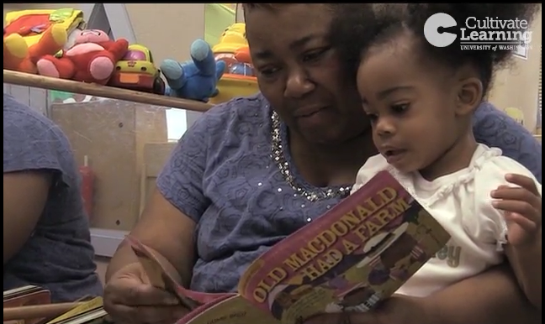
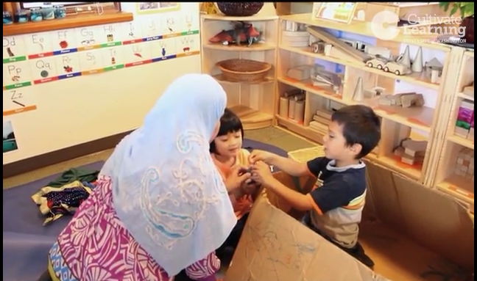
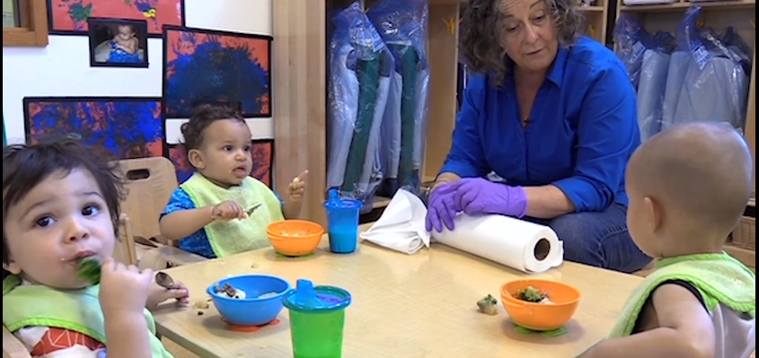
Practices in Action
Old MacDonald
Talking About Animals
Lunch Conversation
Notes:
Here are three Practices in Action videos. You can choose to have all students focus on one or you can have three or more groups and look at all three.
These are in the Mini Lesson: Supporting Language Development which is in your LMS and provides the embed links if you wish to provide students asynchronous access to these resources. This can be useful to allow students to watch it multiple times and be able to complete the handout fully asynchronously. This allows your synchronous class time to be focused on providing guidance and reinforcement, identifying gaps, congruities, and incongruities among learner perceptions.

Slide 38
Working together with the VAF
Complete Video Analysis Worksheet
Focus: Supporting Language Development
Observation: Make sure you solicit all peer perceptions, be specific (use time codes), and provide behavioral descriptions of what participants are doing and how they are interacting related to the focus.
Identify bias: Discuss with your peers what biases or preconceived notions you might have that affect how you understand what you see. Focus on your own biases and wonder about the educator in the video*.
Interpret: Make explicit connections from your observations to the focus supporting language development.
Plan to disrupt bias and improve practice: Brainstorm and develop a few specific plans based on the observation and connected to the focus.
Notes:
* For this exercise if learners are focusing on video of an educator who is NOT themselves, they can only wonder about possible biases, but you want to make sure they don’t assume biases that may or may not be present. Better to have them reflect on possible biases they may have when watching the video. How do they feel about boys and girls doing certain things, do they have beliefs about how different races behave or feel about education, etc. Refer back to the questions from NAEYC position statement on advancing equity f that helps keep them focused on self-reflection.
There are many questions we can explore to become more self-aware about our biases. Here are a few inspired by NAEYC’s Advancing Equity in Early Childhood Education Position Statement (2019):
How do my culture, personal beliefs, values, and biases relate to structural inequities and their impact on children and families over time?
What specific aspects of my background may impact my assumptions about children and families as I build relationships?
When I become aware of a biased action, am I willing to take responsibility, use the opportunity to learn and reflect, resist becoming defensive, and repair the harm?
What other questions might you ask?
Reference: National Association for the Education of Young Children (2019). Advancing equity in early childhood education position statement. https://www.naeyc.org/resources/position-statements/equity

Slide 39
Pulling it all together
How would you describe the Video Analysis Framework (VAF) now?
How might this be useful for you as an educator?
How does focusing your analysis help you understand some of the learning experiences you have already had with young children?
What elements of this framework is challenging or that you find most useful?
What else do you wonder about?
Notes:
Note for instructor: This is an opportunity to check learners' understanding of the VAF and see if any new knowledge or perspective has been developed. You can ask learners what they have learned or now wonder about having completed this round of analysis. It is also a good time to reflect on what is the most difficult skill for them in doing the analysis. You might choose to have them briefly rank the five skills in order of what they find challenging. This allows you to focus your instruction and guidance on the parts they find challenging.
Questions:
How do you understand the Video Analysis Framework (VAF) now?
How might this be useful for you as an educator?
How might the VAF help you understand some of the learning experiences you have already had?
What elements of this framework might have been missing that could strengthen your learning about teaching?
What else do you wonder about?

Slide 40
Educator-Coach Role Play with the
Visual Analysis Framework (VAF)
Notes:
Round #3: Slides 40-46 provide the opportunity to practice using the video analysis framework using role play as an educator and coach
Participants work in pairs and choose their own focus and video, work through observe, identify biases, interpret, plan, and act using the Role Play worksheet in the VAF Handout
Time: Working Together with the Visual Analysis Framework: 60 minutes. This time can vary considerably if you choose to post instructional and practice videos online and have learners prepare their handouts and then use synchronous class time to discuss and refine. Having some synchronous discussion is recommended even if much of the work is done asynchronously.

Slide 41
Learning Outcomes: Educator-Coach Role Play with the VAF
Learners will practice using the VAF with a peer in the role of educator and coach.
Learners will choose a focus from the supplied mini-lessons to analyze video.
Learners will draft their own specific, descriptive, and behavioral observations of selected video in relation to the selected focus.
Learners will compare their observations.
In the educator role, learners will consider their own biases in relation to what they see in the video.
In the coach role, learners will provide their partner educator formative feedback.
Together they will interpret the video in relation to the selected focus.
Together they will build a plan to uncover and disrupt potential bias and improve practice.
Notes:
Please amend the objectives to the fit your content focus if you choose one for the pair of learners.
It may help to have completed the Providing Formative Feedback Learning Activity from Basket 1 before completing this exercise as providing formative feedback is part of this exercise.
Review and Focus​
Review VAF introduction slides: This can include posting the slides 1-11 on the LMS and having learners review together or on their own. The first two pages of the handout also provides a lot of information and may be enough review. Make sure to spend some time helping learners understand the elements of the framework before having them work together to use it.​
Review VAF Handout: Discuss how the handout follows each skill and starts with the focus.
Working Pairs for Role Play​
Form pairs: Each pair should determine who will be the coach and who will be the educator for each round. We recommend that once they choose a mini-lesson they stick with the same focus for both roles, but they may choose to use different practice videos for each role. Each mini-lesson includes at least two practice videos.
Confirm group norms: This is important even when working with just two people. Have each pair confirm what they need to work well together (e.g. listening to each person, deciding on roles, asking each other questions, etc.). If you have already established norms in the course, you can use this time for them to identify anything else they may need while working together (e.g. need to leave my phone on because my child was not feeling well and I may get a call, patience with me because I didn't sleep well last night).​
Post each pair’s mini lesson focus. This lets the other learners know what everyone is working on and provides an opportunity to have pairs who have chosen a similar focus to debrief together.
​

Slide 42
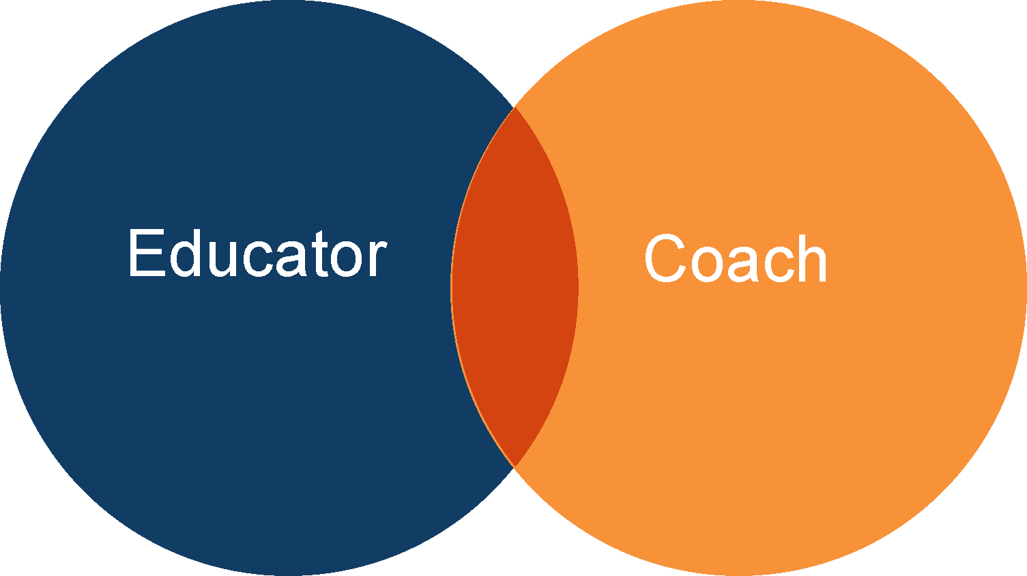
Educator and Coach Brainstorm
What do you know about each of these roles?
What does an educator do? What is their primary perspective?
What does a coach do? What is their primary perspective?
What are some similarities?
Differences?
Imagine what it is like in each role
Notes:
Take a moment with your learners to discover what they understand about the two roles, educator and coach.
Highlight differences in perspectives and ask learners to imagine what it is like in each role. For learners who are also educators this is a good exercise to help extend their perspectives to include coaching. For those who may be new to the classroom this is a good opportunity to explore both roles and and hear from others what their understandings are.
Encourage them to keep their assigned perspective in mind as they move through the analysis process.

Slide 43
Choosing a Focus: Mini-Lessons
STEM
Observation and Assessment
Social and Emotional and Positive Behavioral Support
Supporting Cognition
Documenting Observation
Planning for Ongoing Assessment
Supporting Social and Emotional Development
Transitions
Supporting Emotional Literacy
Rules and Expectations
Communicating with Families
Language and Literacy
Supporting Language Development
Notes:
These are mini-lessons that include short instructional and practices in action videos. You may choose to assign these to different groups or have them choose which ones they want to use as the focus of their video analysis work.
Having multiple pairs share the same focus can raise interesting discussions on the differences in what we each see, what biases we may reflect on, and the interpretations we make. Always connecting back to the evidence in the video or in the instructional videos helps learners see while there may be differences the validity of the work lies in the connection to evidence. This can also be a useful way to assess how reliable your learners are as observers. Can they all identify the practices that are present? Where are the divergences?
You may also choose to share the mini-lessons with your learners online prior to synchronous class time so they can focus their work together on the analysis.

Slide 44
Educator Coach-Role Play
Educator
Coach
Complete Video Analysis Framework Worksheet
Complete Video Analysis Framework Worksheet
Notes:
It is worthwhile to remind learners that they are adopting a specific role. So, it may help to revisit the brainstorm you did before they begin work analyzing together.
Educator Coach Worksheets: The educator will complete the Video Analysis Framework Worksheet (p 3) The coach will complete the Writing Formative Feedback on Teaching Practice Worksheet (p 4). They should do these on their own to prepare for the role play. You may choose to have learners complete this asynchronously or synchronously, depending on your learners. If meeting in-person you can have coaches work together and educators work together and share their work before beginning the role play.

Slide 45
Role Play Guide
Scaffolded conversation sequence
  Educator restates the focus and shares their observations of their own practice.
Coach offers an encouraging strength.
Educator shares reflections on possible implicit biases.
Coach offers alternative practice and wonder.
Educator offers their interpretation.
Coach asks about any goals and offers encouragement.
Educator discusses their plan to disrupt bias and improve practice.
Coach ends with an encouraging strength.
Notes:
Role Play Give each pair at least 15 minutes in each role. A basic feedback process is outlined below. Feel free to encourage role-players to have a natural conversation
It is expected that they may discuss before and after each bullet. Encourage a conversation. This is a process that provides the structure some learners need to have this sort of practice where they are reflecting on biases and providing feedback to others.
Educator restates the focus and shares their observations of their own practice.
Coach offers an encouraging strength.
Educator shares reflections on possible implicit biases.
Coach offers alternative practice and wonder.
Educator offers their interpretation.
Coach asks about any goals and offers encouragement.
Educator discusses their plan to disrupt bias and improve practice.
Coach ends with an encouraging strength.
Practicing with videos of other educators and adopting different perspectives will help build the skills you want learners to use with one another as they begin to analyze videos of their own practice together.
Note: Online asynchronous delivery of this is possible by pairing students up and providing an online space for them to post their responses and reflections with this process guide. Or if you have a video annotation tool.

Slide 46
Formative Feedback
Positive observations (e.g., “You did a great job getting down to the child’s level and making eye contact, which they smiled at.”)
Connections to content (e.g., “Including ‘eager’ along with ‘disappointed’ and ‘frustrated’ was a great expansion of their positive emotional vocabulary.”)​
Alternative practice (e.g., “I wonder how he would respond if, instead of telling him what you see in his painting, you asked him ‘what’s going on here?’”)​
Wonder (e.g., “I wonder what else you might 'do' to practice emotional literacy.”)​
Encouragement (e.g., “It will be super to see what your next steps are!”)
Notes:
You can share this slide to remind the coach role what is included in formative feedback and help their completion of the Writing Formative Feedback on Teaching Practice Worksheet
This is also included in Basket 1 Learning Activity Providing Formative Feedback

Slide 47
Pulling it all together
How do you understand the Video Analysis Framework (VAF) now?
How did it feel being in the educator role?
How did it feel being in the coach role?
What helped you feel like you could improve your practice as the educator?
What helped you feel like you could support the educator as a coach?
What else do you wonder about?
Notes:
Note for instructor: This is an opportunity to check learners' understanding of the VAF and see if any new knowledge or perspective has been developed. You can ask learners what they have learned or now wonder about having completed this round of analysis. It is also a good time to reflect on what it is like providing and receiving feedback. If they found anything particularly challenging, this step allows you to focus your instruction and guidance on the parts they find challenging.
You may also choose to have learners post their worksheet pages or share in groups. Making learning visible across pairs can help everyone’s learning.

Slide 48
References
Derman-Sparks, L., J.O. Edwards, & C.M. Goins (2020). Anti-bias education for young children & ourselves. Washington D.C.: NAEYC.
Packard, M. Brennan, C. Joseph, G., Emerson-Hoss, K. (2021). The power of video analysis: Developing
professional vision and anti-bias practices for pre- and in-service teachers. Young Children, 77(1) https://www.naeyc.org/resources/pubs/yc/spring2022
NAEYC (2020). Developmentally appropriate practice position statement. https://www.naeyc.org/resources/position-statements/dap/contents
National Association for the Education of Young Children (2019). Advancing equity in early childhood education position statement. https://www.naeyc.org/resources/position-statements/equity

