Slide 1
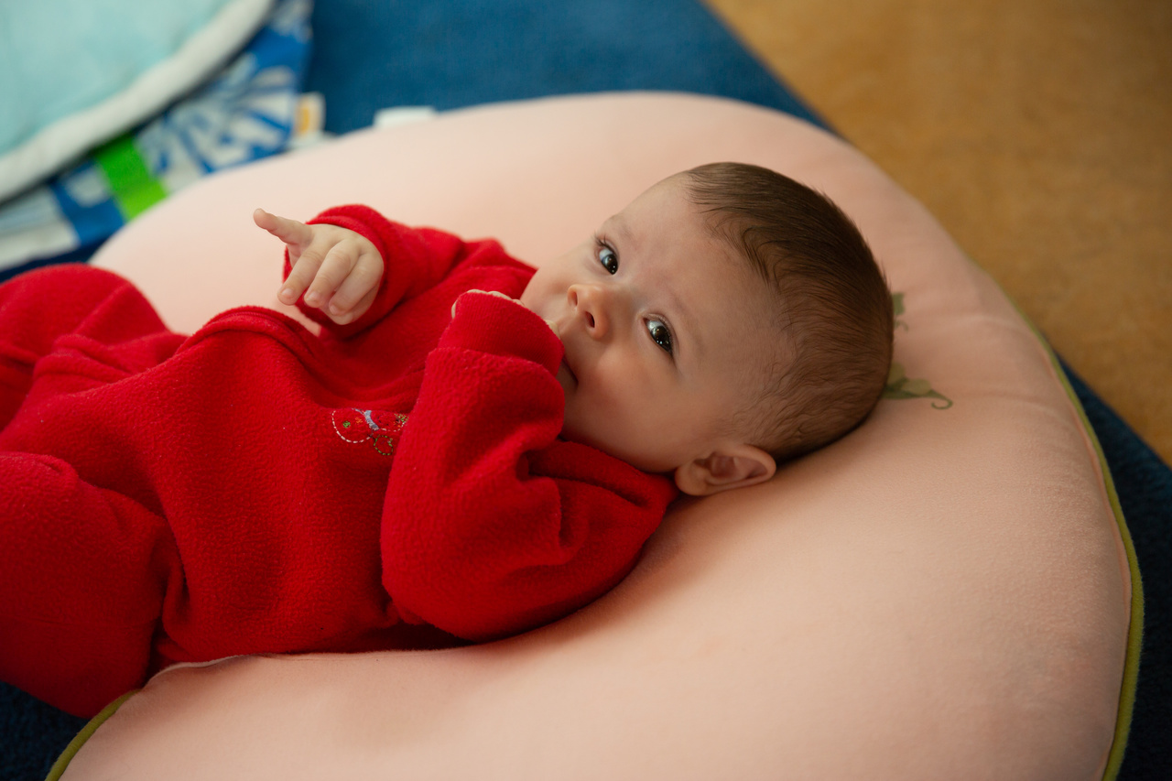
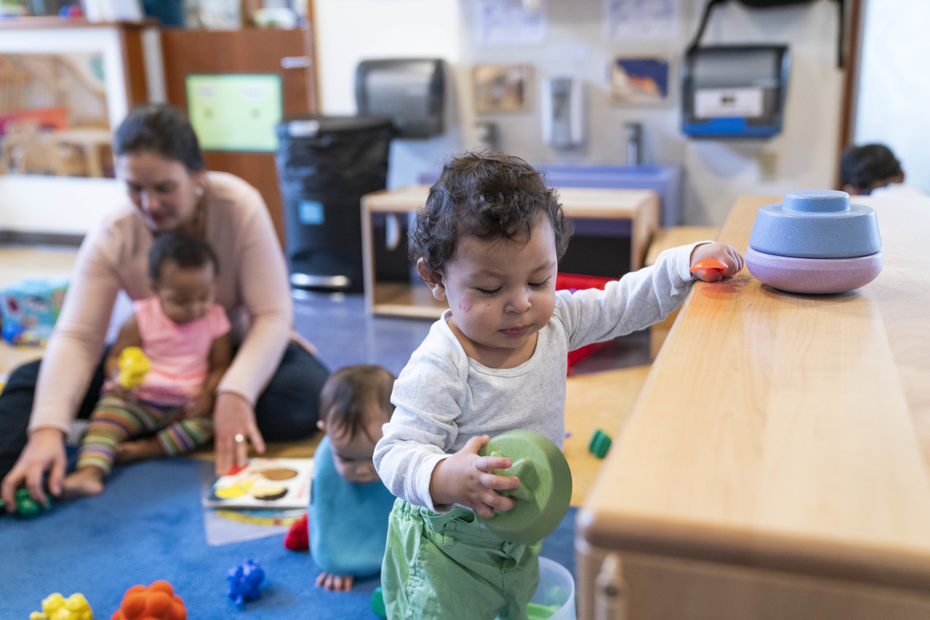
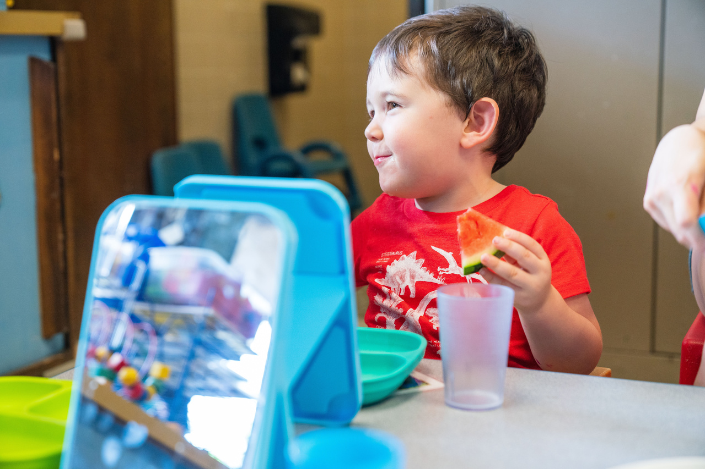
Curriculum Modifications
for Infants and Toddlers

Slide 2
Objectives
Define curriculum modifications
Describe the purpose and uses of curriculum modifications
Show examples of curriculum modifications
for infants and toddlers

Slide 3
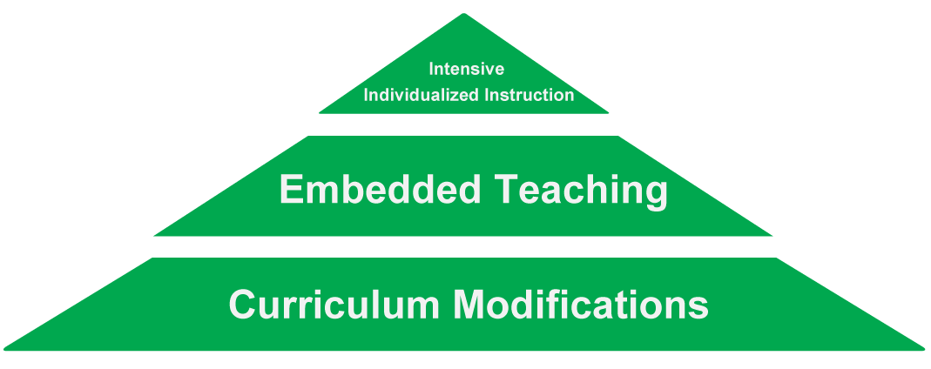
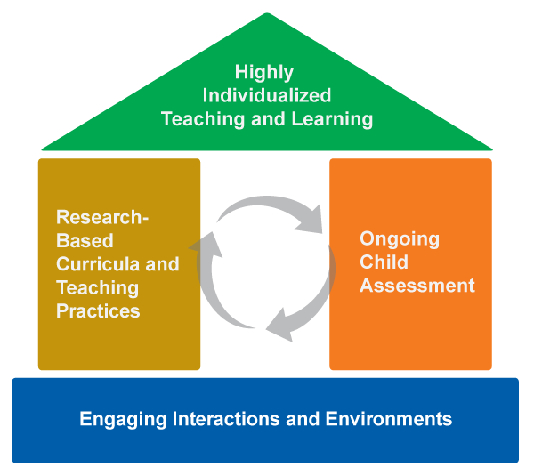
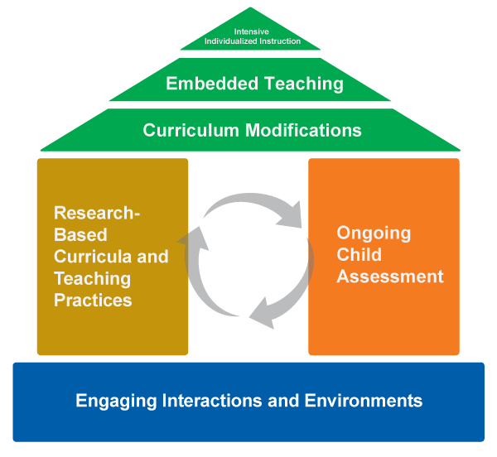
Framework of Effective Practice

Slide 4
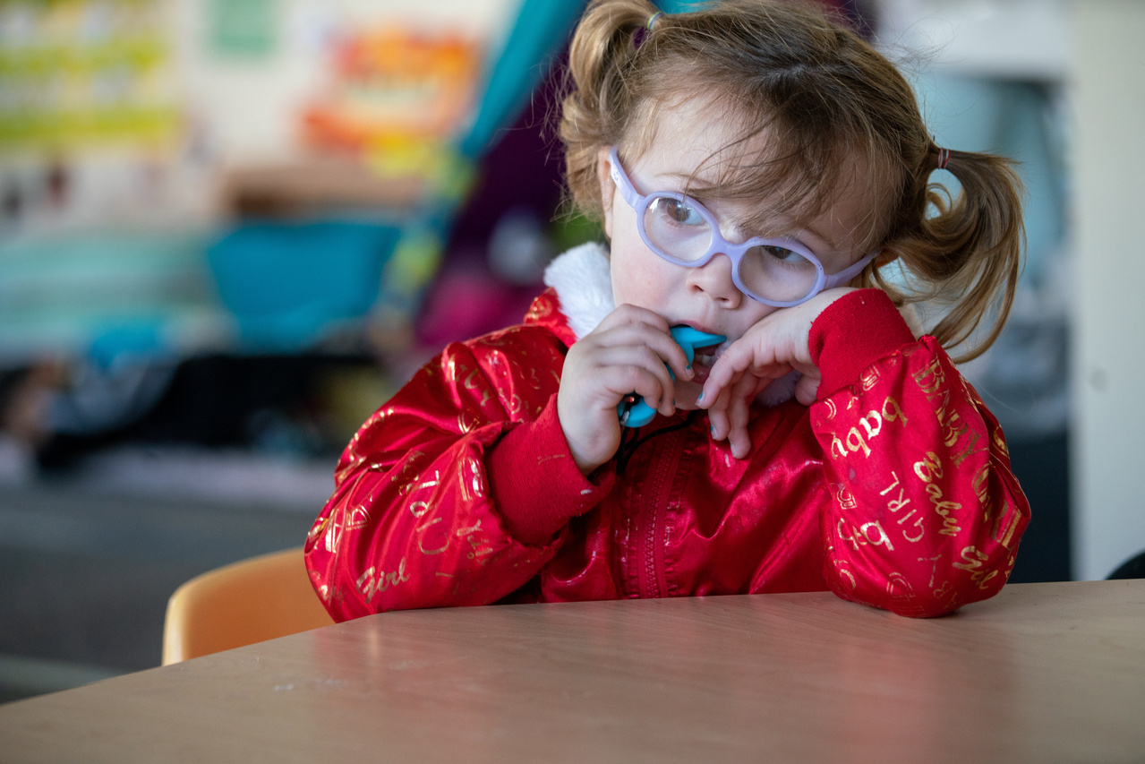

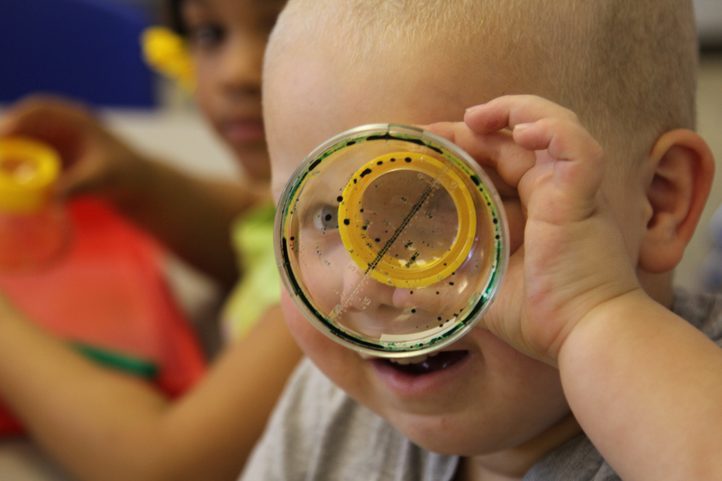
Curriculum Modifications
WHAT
WHY
WHEN

Slide 5
What is a Curriculum Modification?
A change to the environment, activity, or materials in order to facilitate or maximize a child’s participation in planned activities, interactions, and routines.
A DEC Recommended Practice

Slide 6
What is a Curriculum Modification?
SMALL CHANGE,
BIG IMPACT

Slide 7
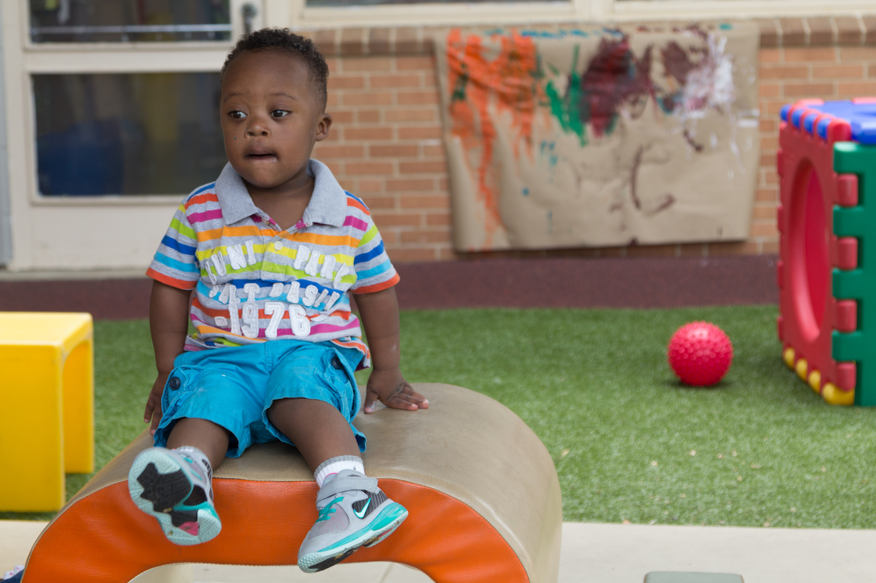
When Do I Modify the Curriculum?

Slide 8
Why Modify the Curriculum?
Increased
access
Increased
participation
Increased
learning!

Slide 9
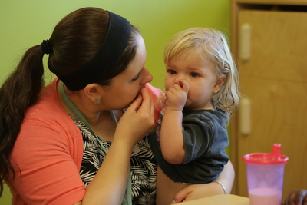
Learning Activity:
Routines and Participation

Slide 10
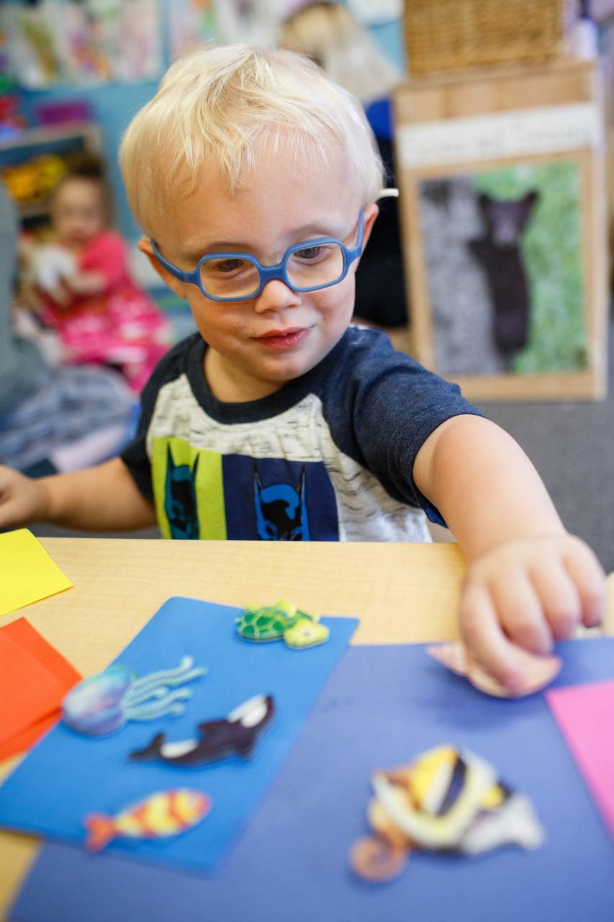
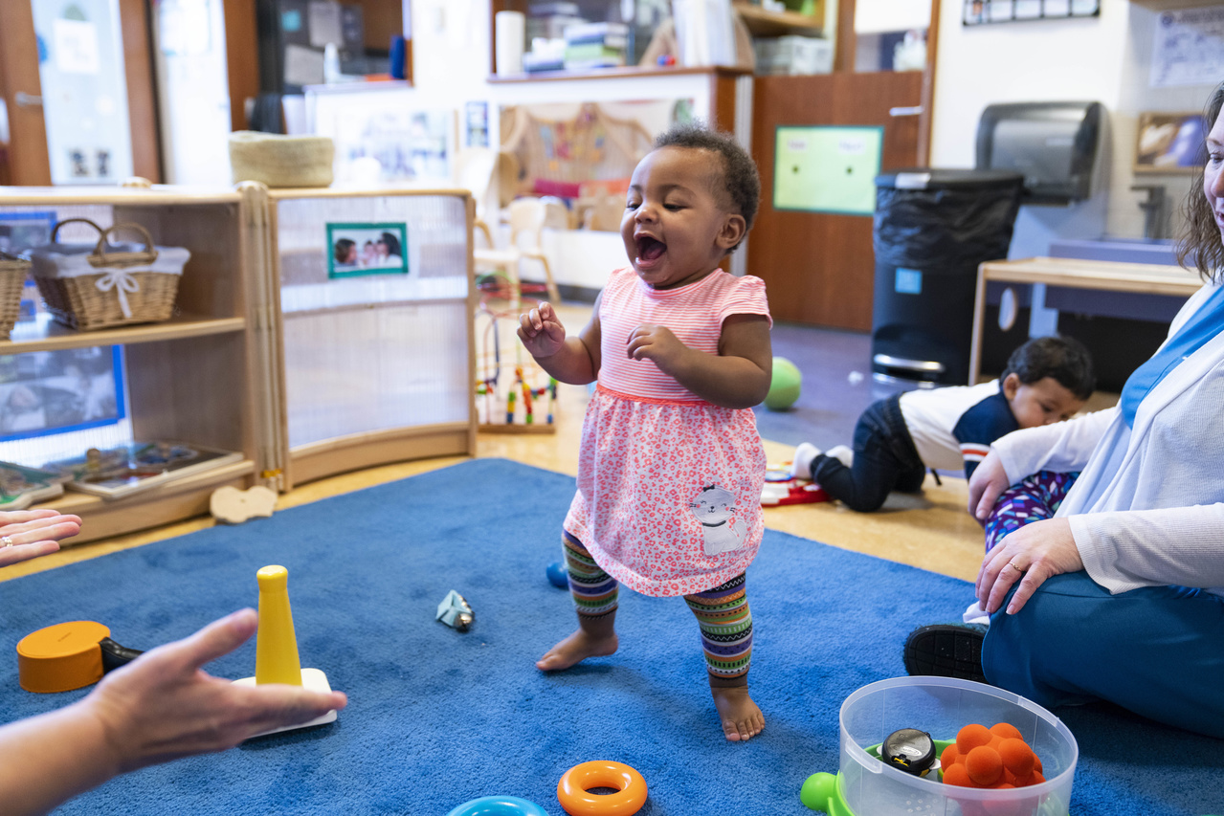
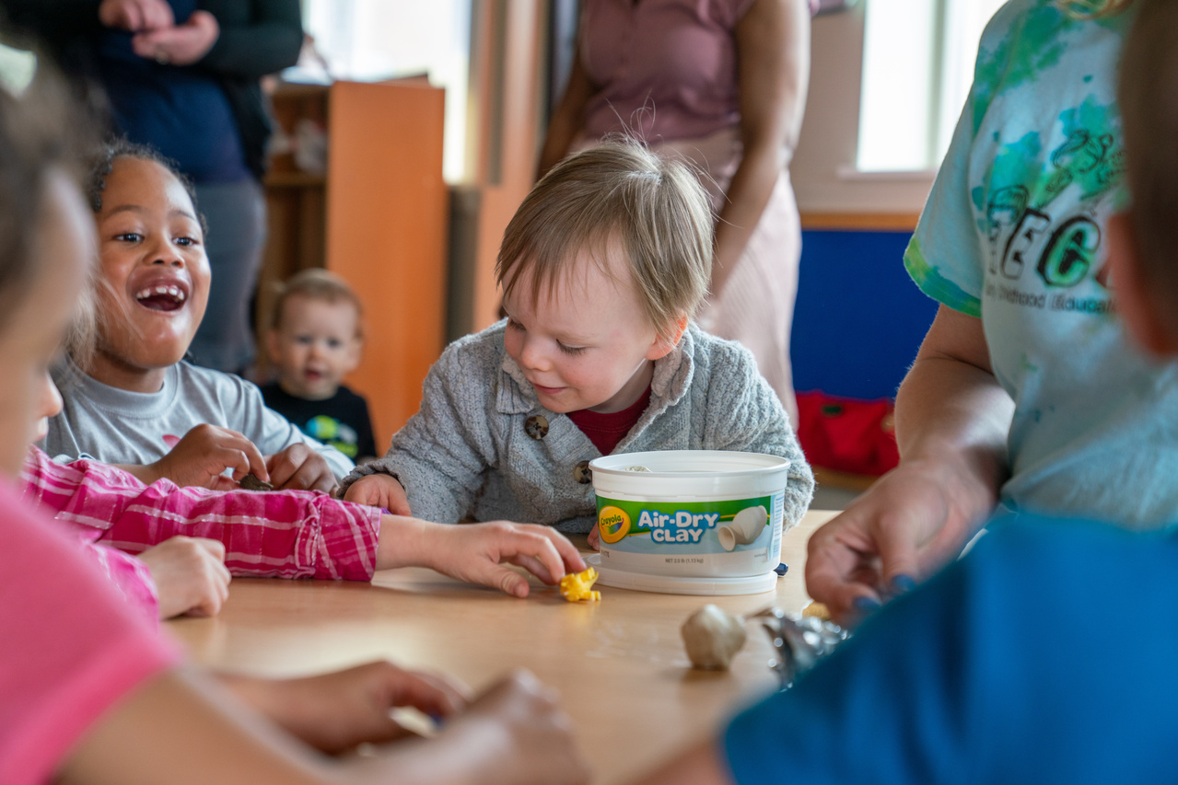
Participation

Slide 11
8 Types of Curriculum Modifications
Environmental Support
Special Equipment
Materials Adaptation
Adult Support
Simplify the Activity
Peer Support
Child Preferences
Invisible Support

Slide 12
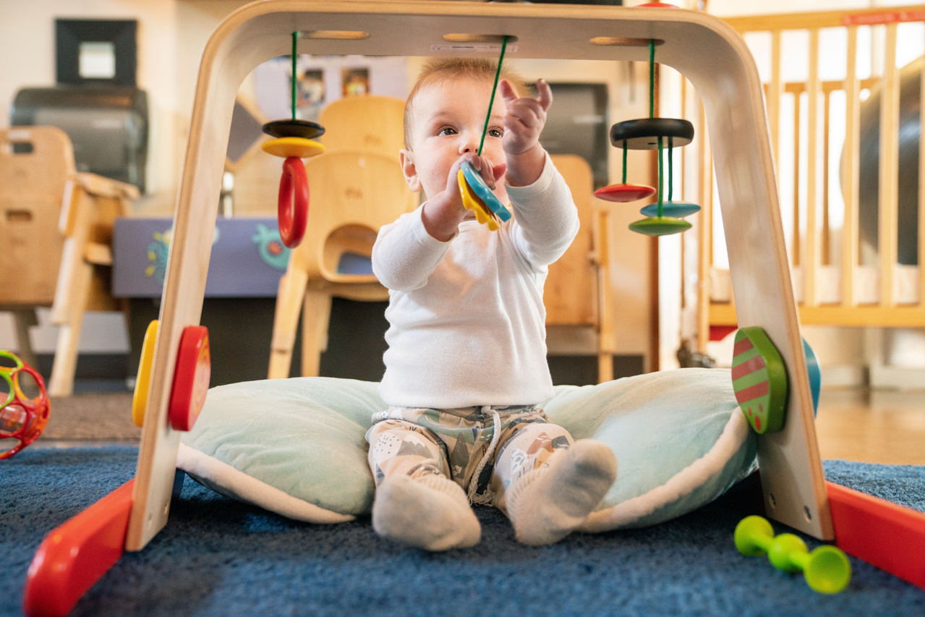
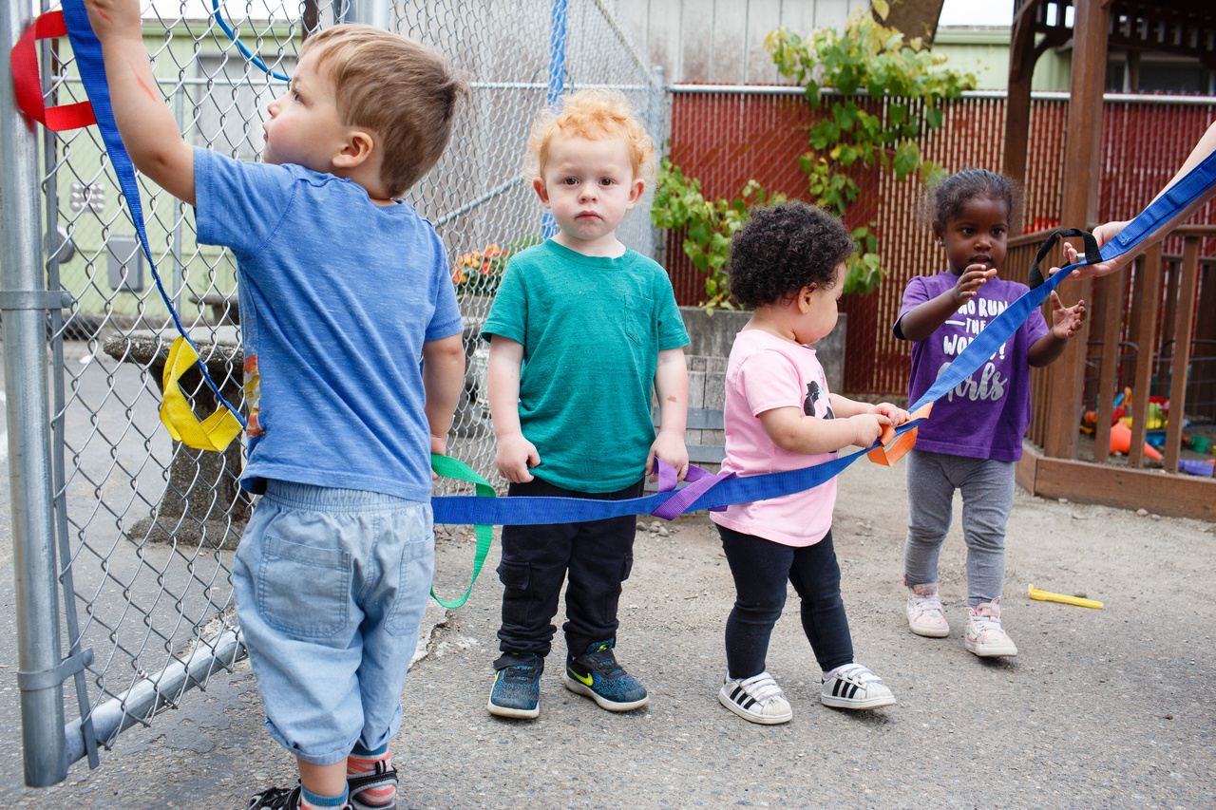
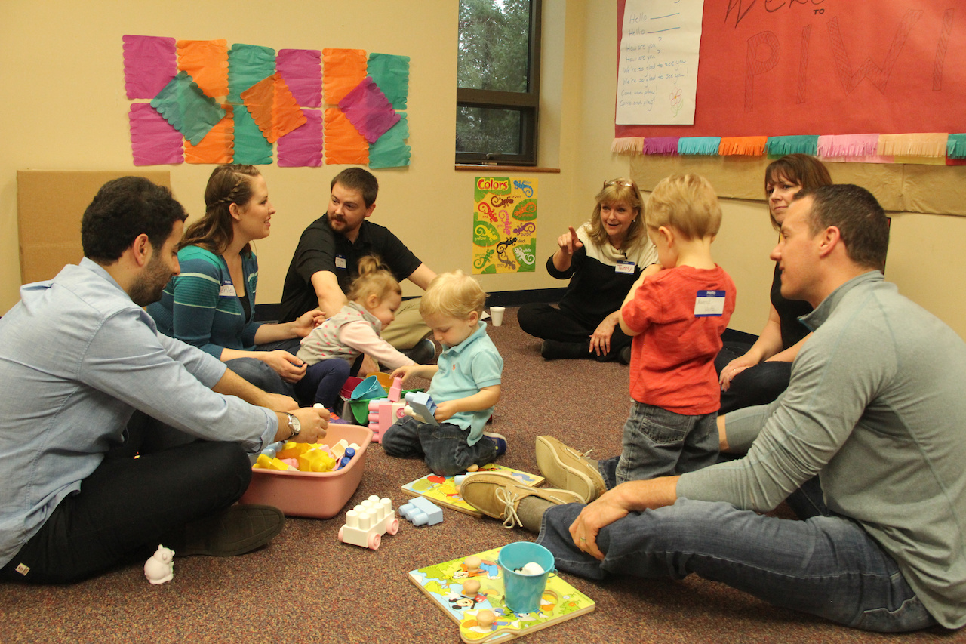
Environmental Support
Altering the physical, social, and temporal environment to promote participation and learning.

Slide 13
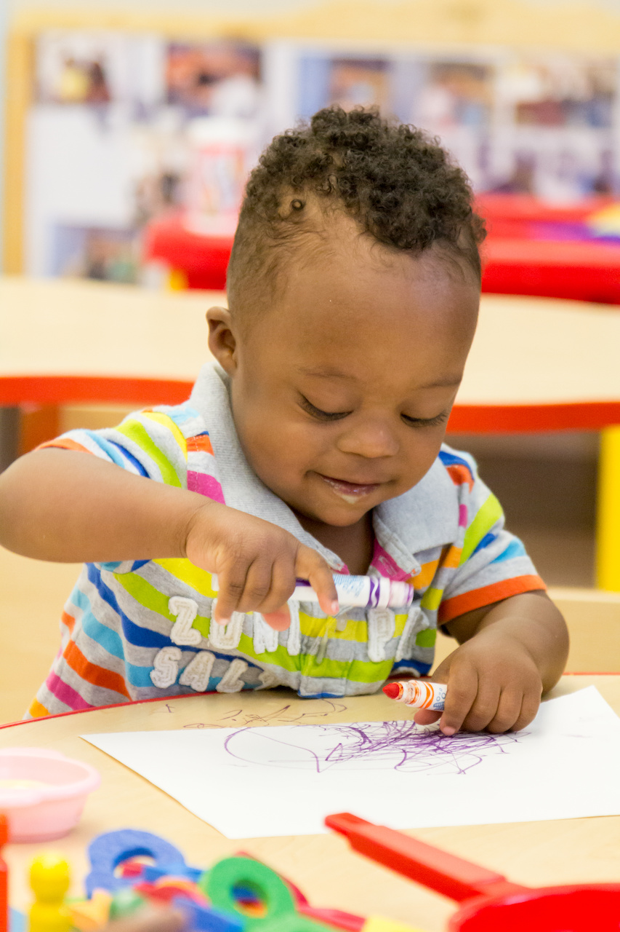
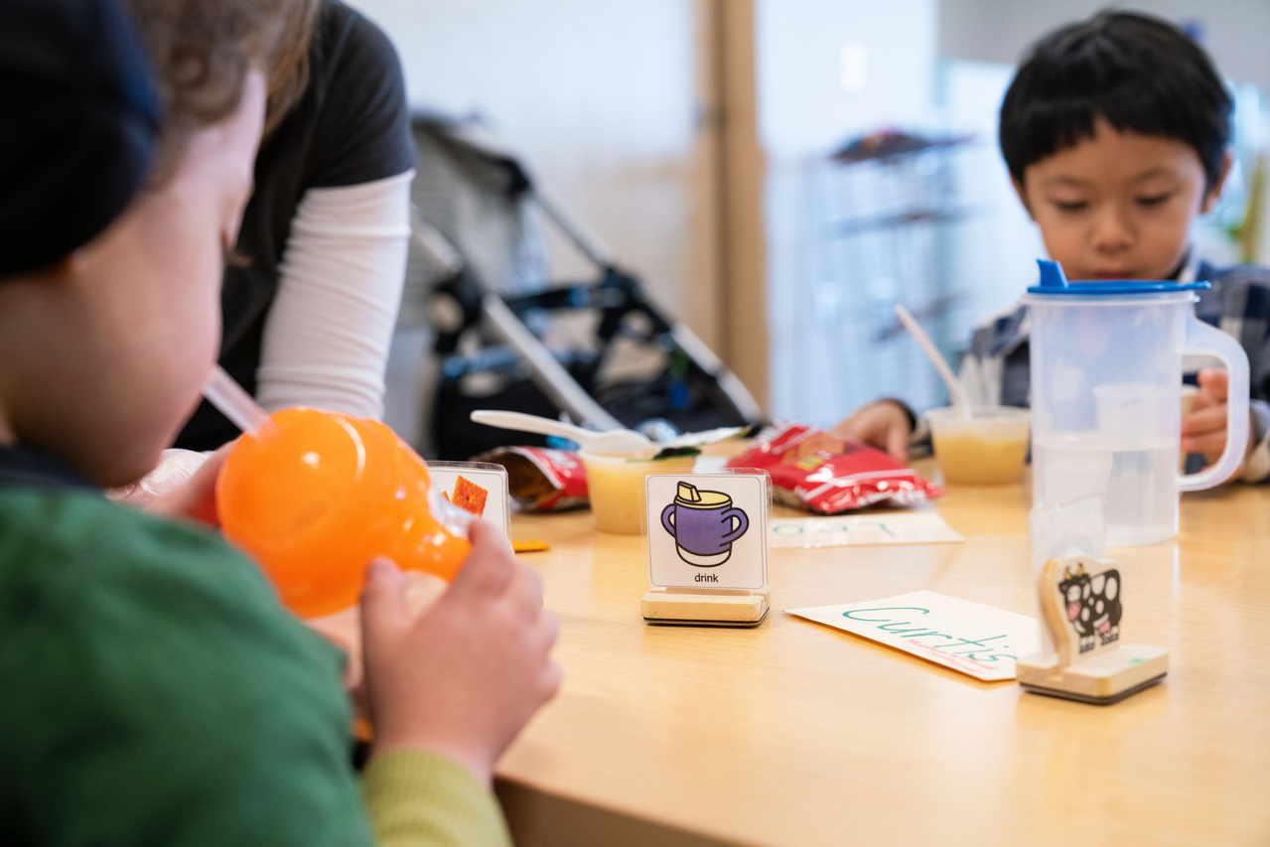
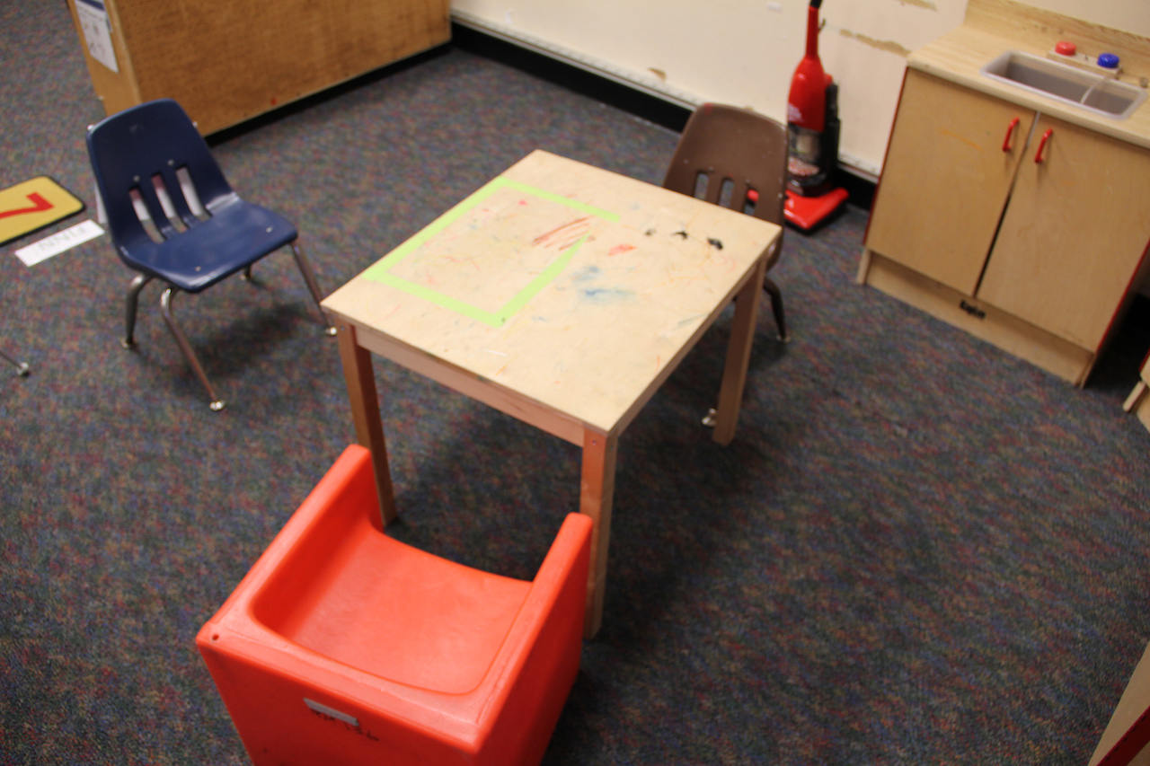
Materials Adaptation
Modifying materials so that the child can participate in a meaningful way.

Slide 14
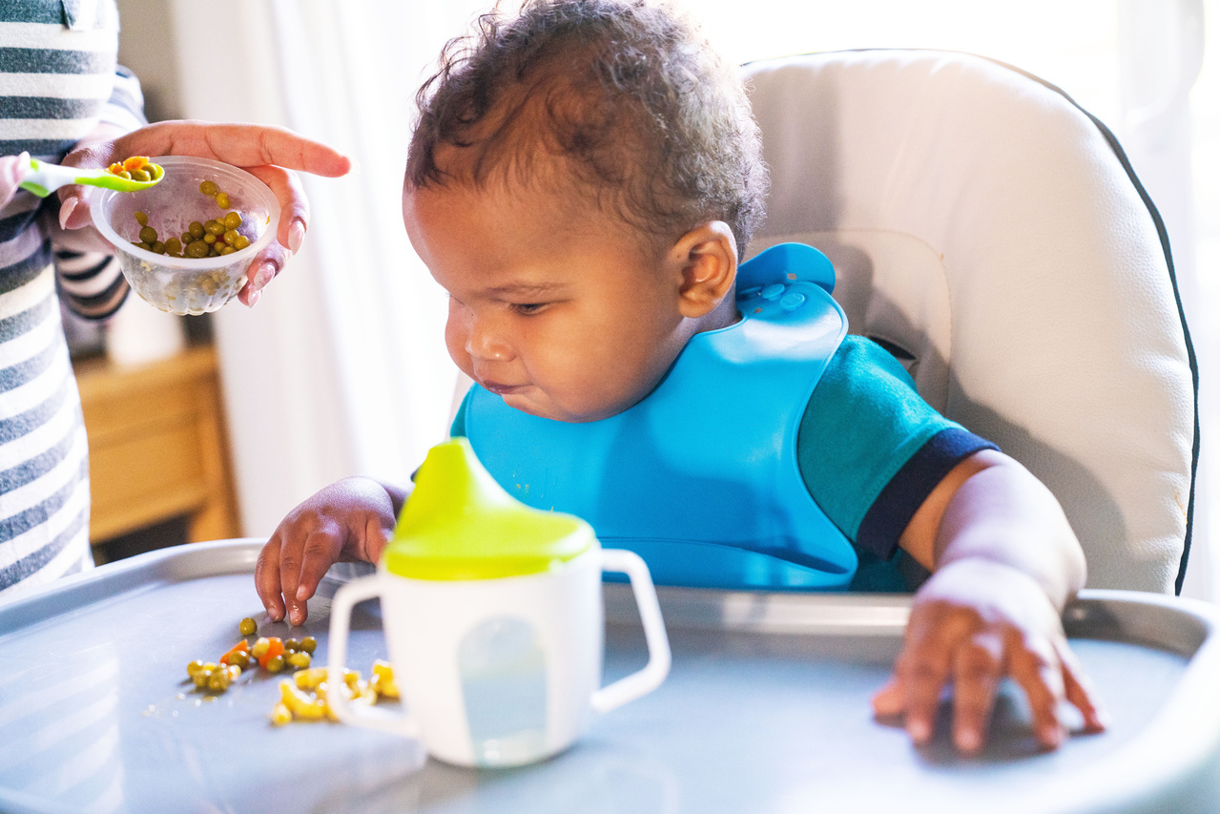
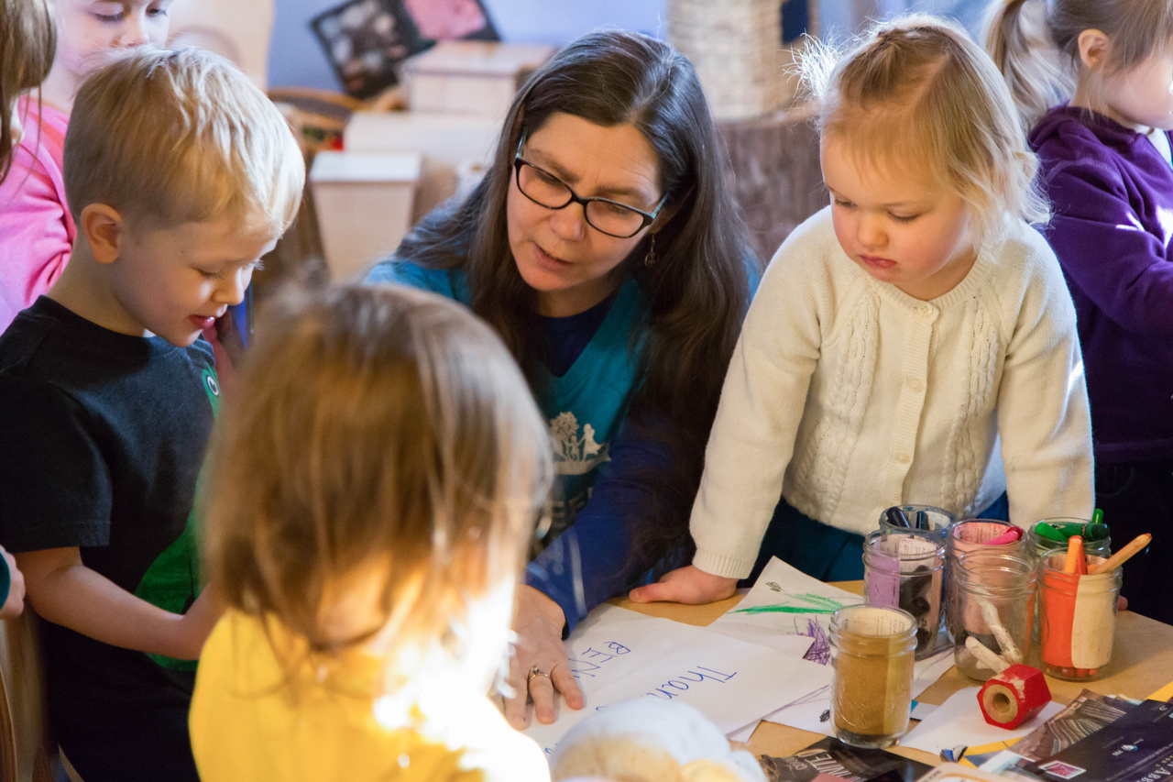
Simplify the Activity
Simplifying a complicated task by breaking it down into smaller parts or by reducing the number of parts.

Slide 15

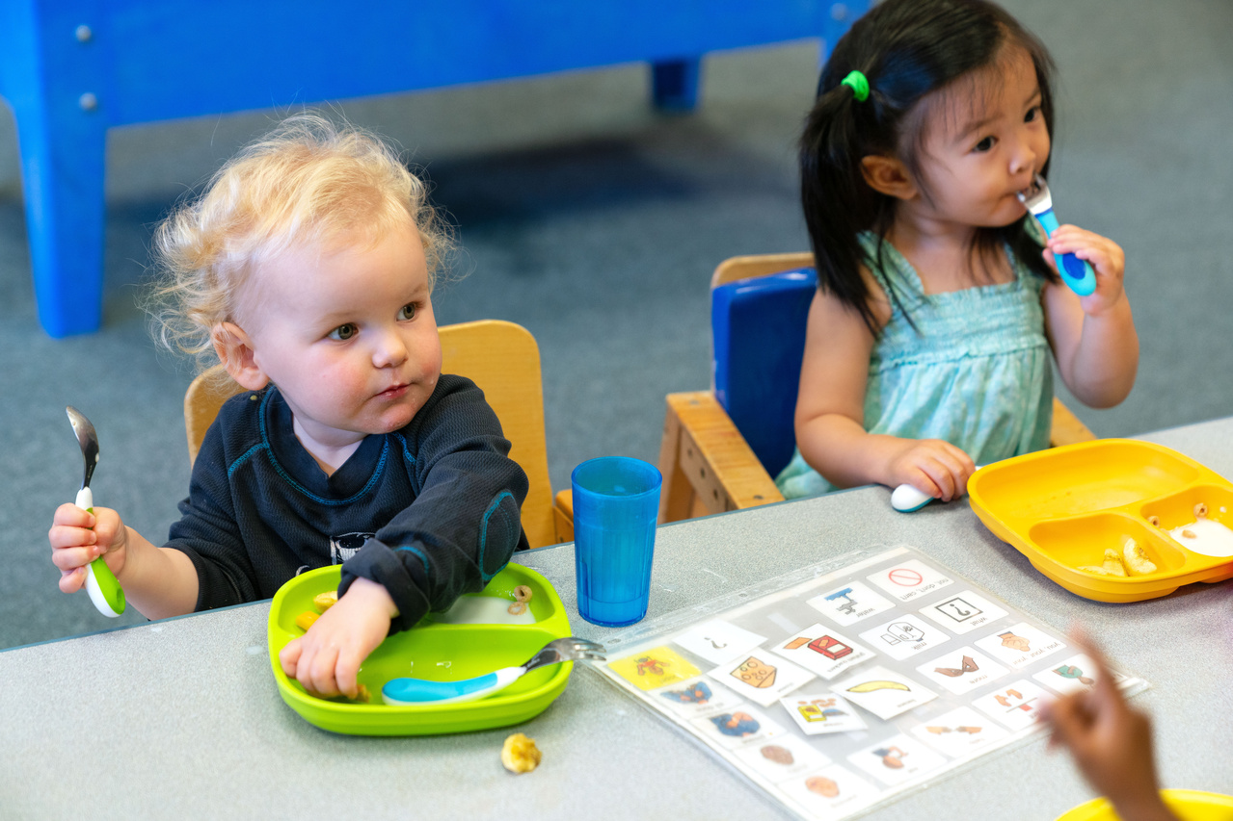
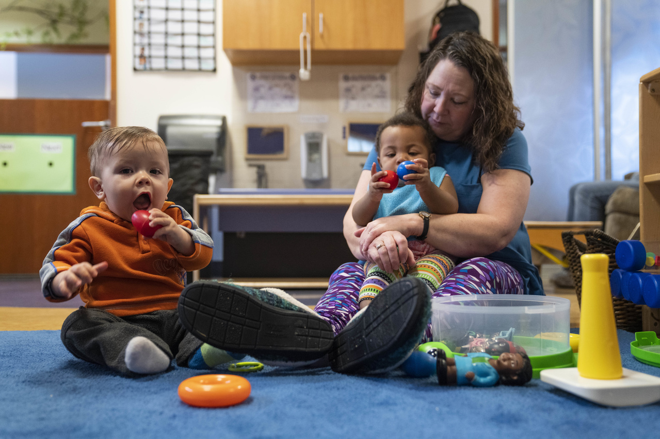
Child Preferences
If the child is not taking advantage of the available opportunities, identify and integrate
the child’s preferences.

Slide 16
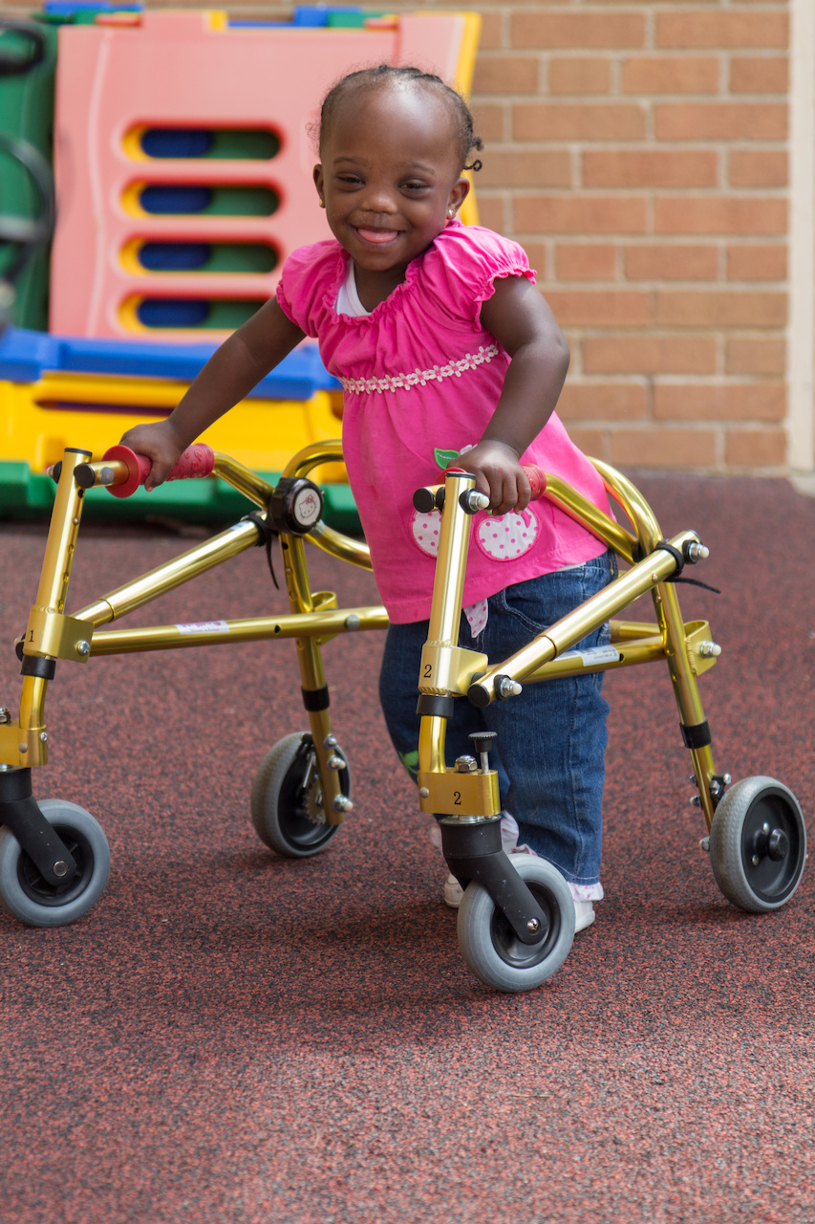
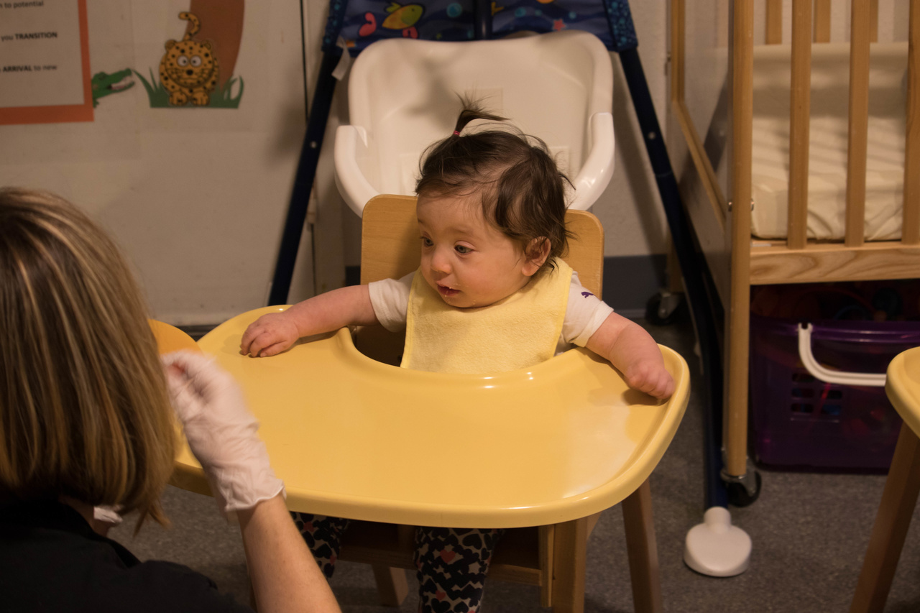
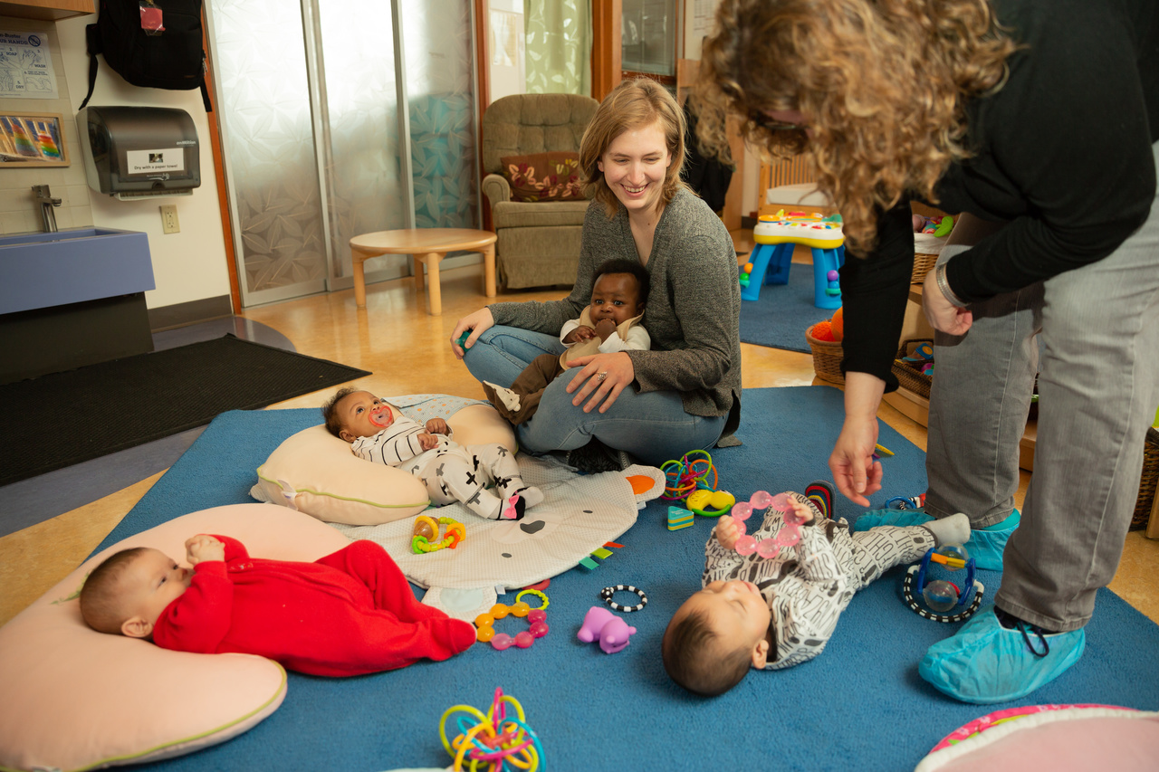
Special Equipment
Using special or adaptive devices that allow a child to participate or increase the child’s level
of participation.

Slide 17
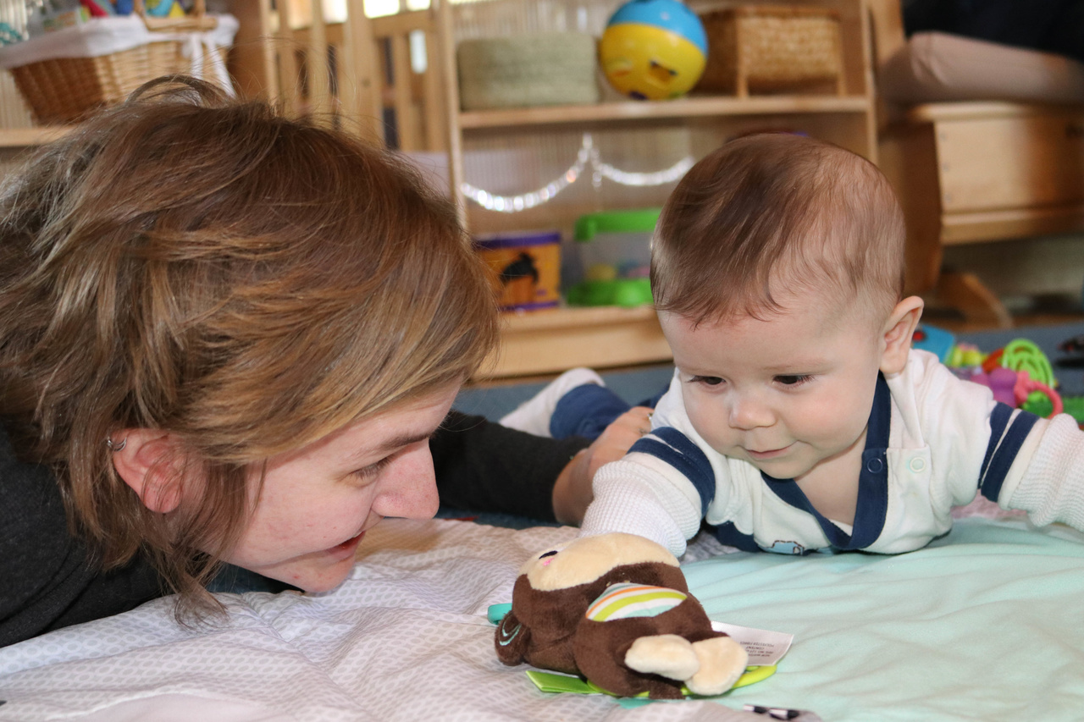
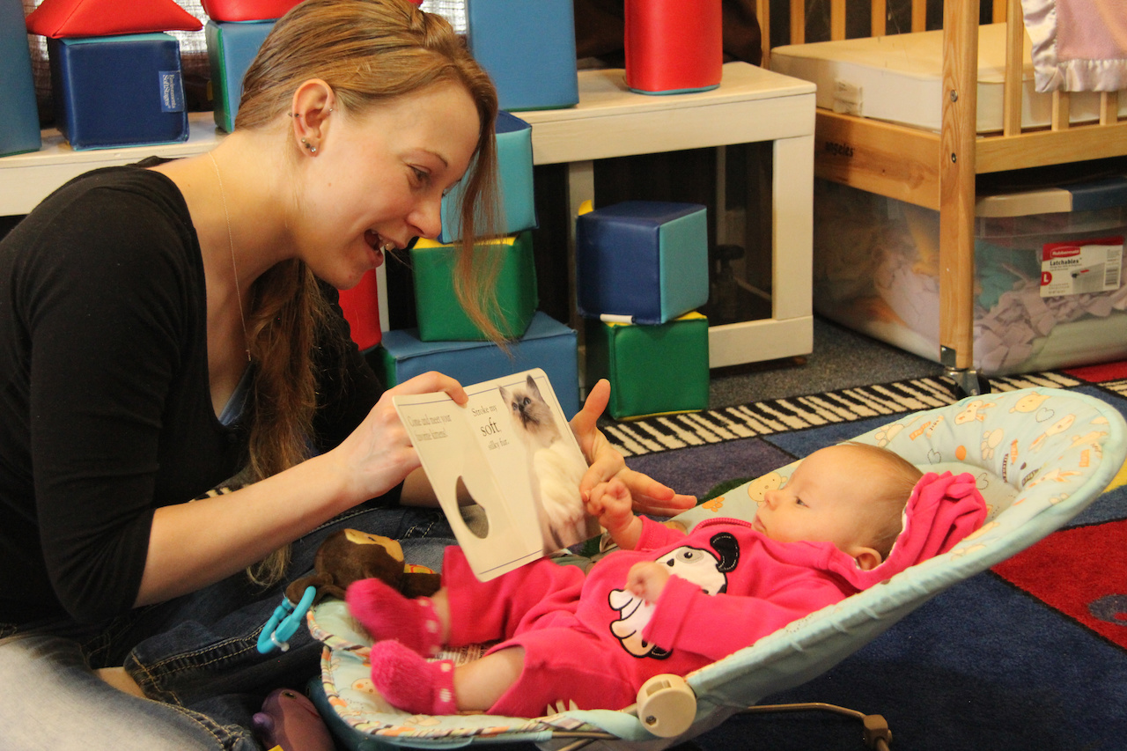

Adult Support
Having an adult intervene to support the child’s participation and learning.

Slide 18
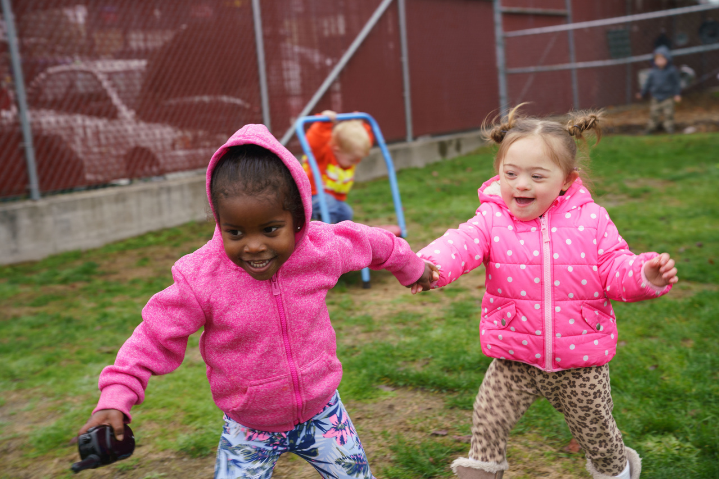
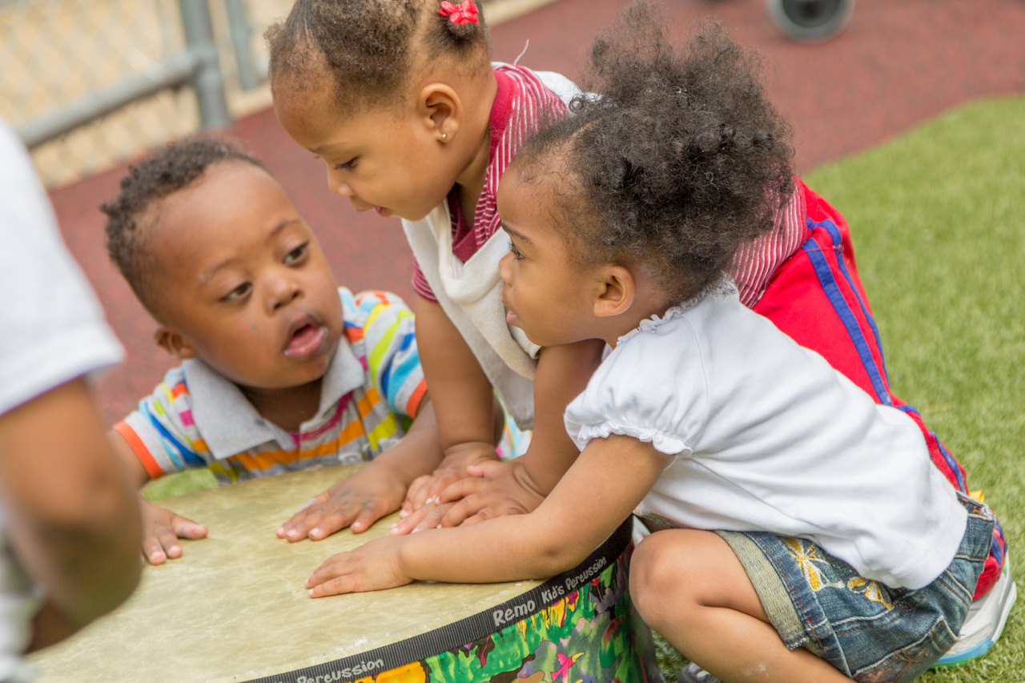
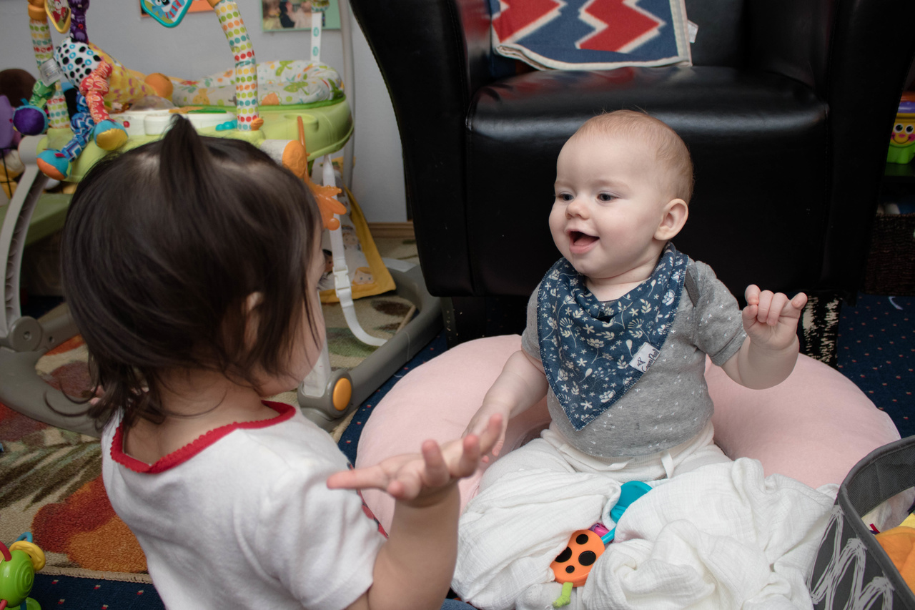
Peer Support
Using peers to help the child learn important objectives.

Slide 19
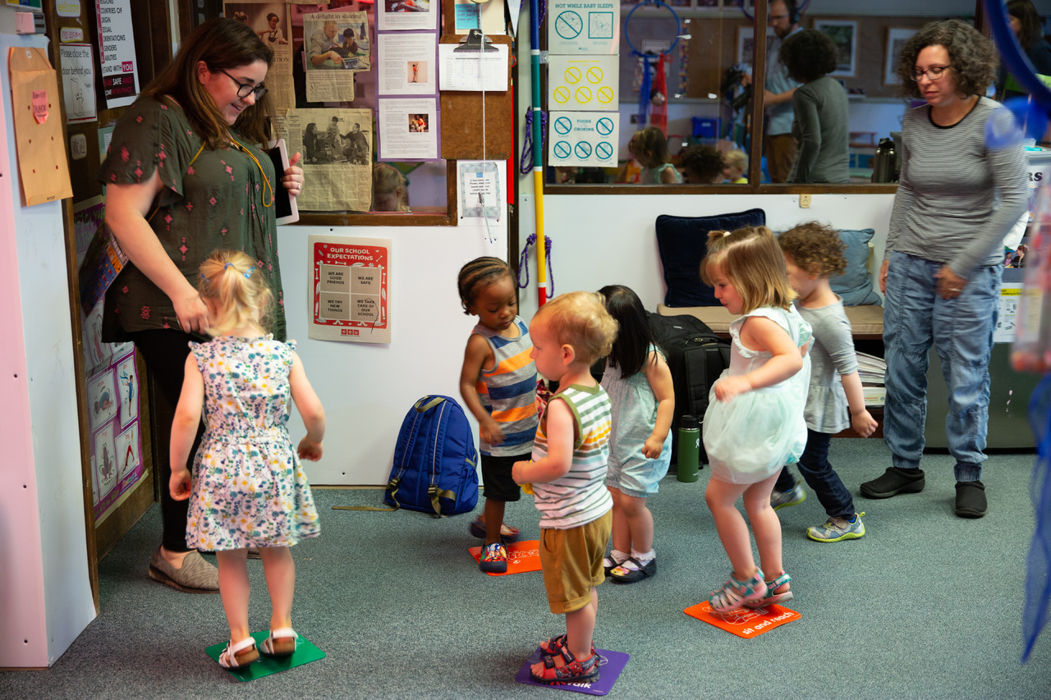
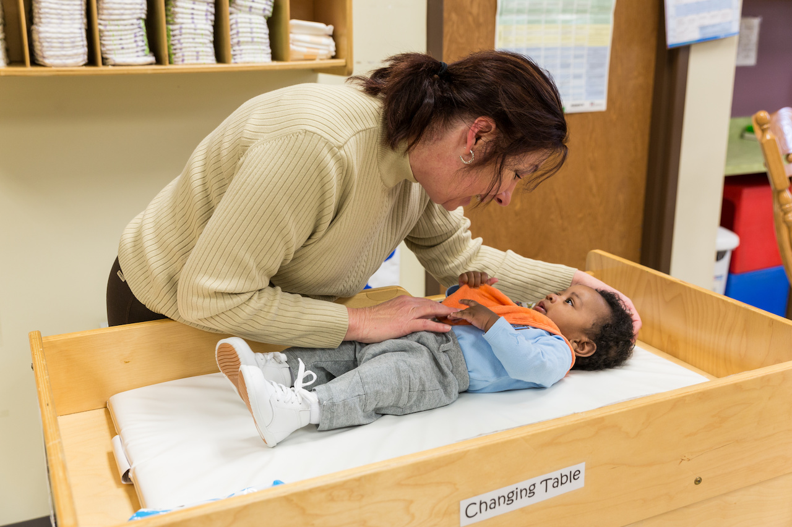
Invisible Support
Purposefully arranging naturally occurring events within an activity.

Slide 20
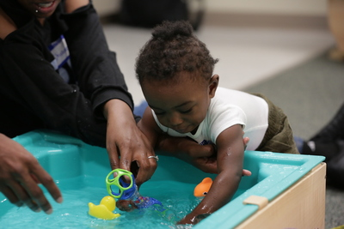
Learning Activity:
Choosing Modifications

Slide 21
Review
Today, we:
Defined curriculum modifications
Described the purpose and uses of curriculum modifications
Shared examples of curriculum modifications for infants and toddlers

Slide 22

Thank You!
See the Head Start Center for Inclusion website for more resources: www.headstartinclusion.org

